Slide 1
First International Conference on ANTICIPATION 5-7 November 2015, Trento (Italy) Biourbanism Towards a new epistemology in the architects’ education Dr. Eleni Tracada, University of Derby, College of Engineering and Technology Email: E.Tracada@derby.ac.uk Dr. Antonio Caperna, International Society of Biourbanism, Rome, Italy Email: antonio.caperna@biourbanism.org

Slide 2
Challenges to contemporary architecture
Contemporary culture has generated new challenges for architectural education systems.
Globalization, fast urbanisation, climate change, natural and environmental degradation, is a set of interconnected challenges.
At the same time contemporary architecture has become part of the new global culture in which images have become a substitute for reality.
Architecture could be seen as the supreme medium of contemporary visual culture, especially in its potential to influence the individual′s perception of reality as a component of the mass–media system.
Social sciences studies demonstrate that contemporary architecture can affect negatively everyday urban life; Psychology and medicine show how space design can nurture or damage our well-being.
The above challenges call for new epistemological and scientific foundations of architecture and urbanism. Education should be the first step to help us to produce really sustainable new design for the 21st century.

Slide 3
A new educational approach in Biourbanism
Biourbanism has the potential to educate the next generation of architects and enable them to create original and human oriented designs.
The integration of Biourbanism principles could improve the quality of architectural education.
The theoretical framework of Biourbanism, such as the structural approach and the laws of form combined with emergent fields, such as Neurophysiology and Environmental Psychology could be easily integrated in architectural education.
Some practical experiences were applied by our International Society of Biourbanism team in three consecutive summer schools and in some modules taught in HE in the UK recently.

Slide 4
A new educational approach in Biourbanism
By embedding Biourbanism learning objectives in Higher Education today, we do not only set clear learning outcomes in specific modules and programmes, but also we can generate sound educational assessment methods guaranteeing focused future predictions of urban growth.
The use of live projects in the delivery of modules linked to Biophilic Design and Biourbanism can offer us the opportunity to get educators from a variety of disciplines, from sciences, design and architecture.
Hence, active learners should be able to morph the future of urban space by successfully inputting their educational experiences into innovative new designs governed by Biourbanism.
Early investigation and research carried out during projects offers the opportunity to teachers and learners to share common experiences and evaluate important factors of anticipation of future events, such as the life span of urban areas and their future mutations; these processes are necessary to the survival and evolution of both natural and built environments.

Slide 5
New methods of designing or revitalising cities today follow new forms of Urbanism, such as Biourbanism:
Biourbanism introduces new conceptual and planning models for a new kind of city, which values social and economical regeneration of the built environment through developing healthy communities.
Biourbanism combines technical aspects, such as zero-emission, energy efficiency, information technology, etc. and the promotion of social sustainability and human well being.

Slide 6
A new educational approach in Biourbanism
Biourbanism endorses principles of geometrical coherence, Biophilic design, Bio Architecture, Biomimesis, etc. in practices of design and also new urban policies to promote urban revitalization by ensuring that man-made changes do not have harmful effects to humans.
Green city standards may originate inside the designs for each building and carry on affecting either unbuilt spaces surrounding buildings or even complex infrastructural networks and connections of buildings and people.
New exciting developments recently, such as fractals, complexity theory, evolutionary biology and artificial intelligence are interrelated and constantly stimulate interaction between human beings and the surrounding built and natural environment.

Slide 7
A new educational approach in Biourbanism
The epistemological reformulation of architecture according to Biourbanism refers to the “study of the form” in contraposition to the study of the matter. It implies a dynamical and evolutionary study of the “structures” where the relationships (internal and external) have a significant role in the evolution of processes.

Slide 8
Bonding and Place attachment – Human emotions
Bonding is central to human experience; we form meaningful connections with particular people, groups, objects and places.
Connections situate and secure us in broader social and physical environments; they connect us to the past and influence our future behaviours.
Attachment theory focuses on person-to-person bonding with other people and specific places.

Slide 9
Bonding and Place attachment The role of environmental psychology today
“Attachment theory … proposes that an innate psychological system regulates proximity to an ‘attachment figure,’ a specific person who provides an individual with security and comfort in the face of threats and … facilitates their growth…, as environmental psychologists and others have shown, most people also develop bonds with places.”
(Scannell & Gifford, 2014)

Slide 10
"the belief that human tastes are reversible cultural preferences has led social planners to write off people's enjoyment of ornament, natural light, and human scale and force millions of people to live in drab cement boxes. ... the conviction that humanity could be reshaped by massive social engineering projects led to some of the greatest atrocities in history." (Pinker, pages x-xi). Pinker underlines the disastrous consequences of turning against the human nature, by accusing architects, planners and legislators for acting contrary to the biological nature of the human beings. This biological connection, as said, is a very important focus for us. It is becoming increasingly clear that architectural value is indeed founded on shared aspects of the human mind (Salingaros, 2011). Such as universality relies on innate neural circuitry common to all human beings (Pinker, 2002).
The connection between architecture, urbanism and inherited structures in the human brain that influence the function of ‘mind’ become a study area able to formulate a new epistemological basis of architecture and urbanism.
(Caperna, Tracada, 2015)

Slide 11
Why the architectural paradigm of Biourbanism is different than any rationalistic theories?
What is our educational model for the future anticipating new developments and growth?
You see what we have proposed as new educational model and we also started applying it. It anticipates the future of sustainable cities according to laws of nature.

Slide 12
Groundwork of Biourbanism science
(i) Epistemic foundation and the needed scientific paradigm shift, (ii) New life sciences, as biological roots of architecture and urbanism; (iii) Peer to Peer Urbanism as an innovative way of conceiving, constructing, and repairing the city; (iv) Morphogenetic Design Processes, based on real recognition of “optimal forms” defined at different feedback scales (from physiological, to ecological), which, through morphogenetic processes, guarantee an optimal systemic efficiency, and therefore quality of life. (Source: Caperna, 2011).

Slide 14
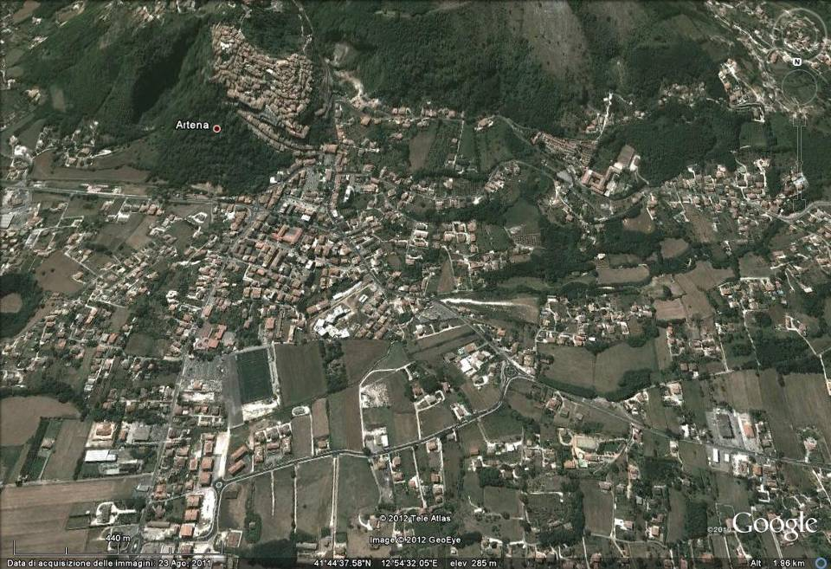
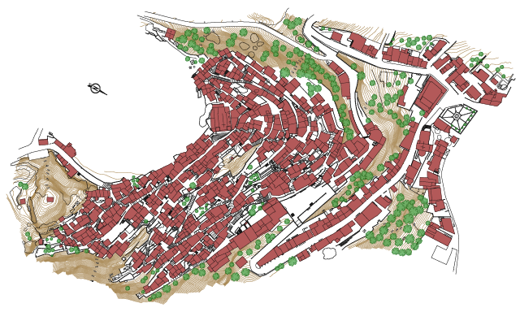
Summer Schools and Biourban Acupuncture

Slide 15
Smart Community- Artena
Social capital
Economical capital
Cultural growth
Town and country planning acconrding to Biourbanism approach

Slide 16
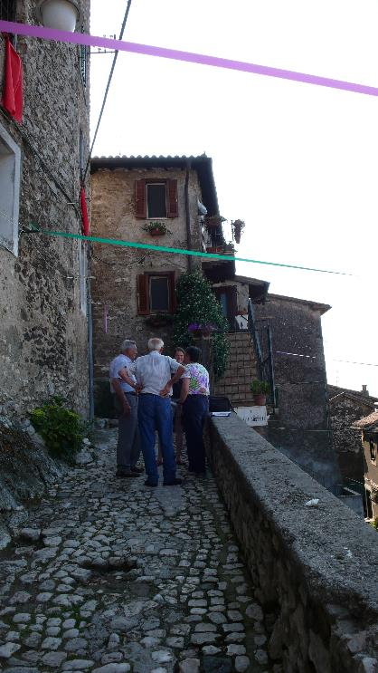
Artena Village, Province of Rome, Italy

Slide 17
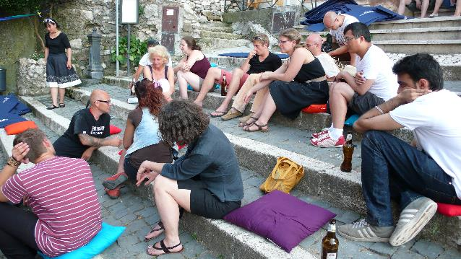
Artena Village, Province of Rome, Italy

Slide 18
Artena Village, Province of Rome, Italy Collaborative projects in ‘Ruin Academy’

Slide 19
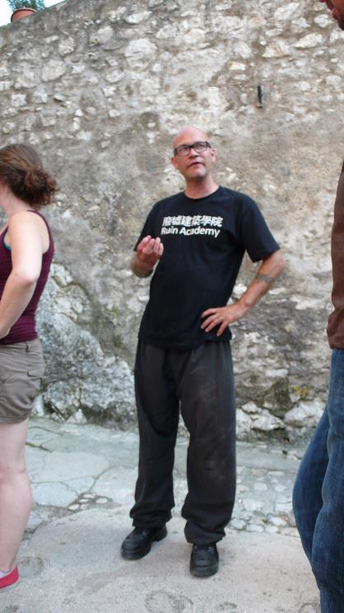
Artena Village, Province of Rome, Italy ‘Ruin Academy’ founded by Marco Casagrande

Slide 20
Artena Village, Province of Rome, Italy ‘War Memorial Garden’, 2013 – inside a site bombed during World War II

Slide 21
Thank you for your attention.

