Slide 1
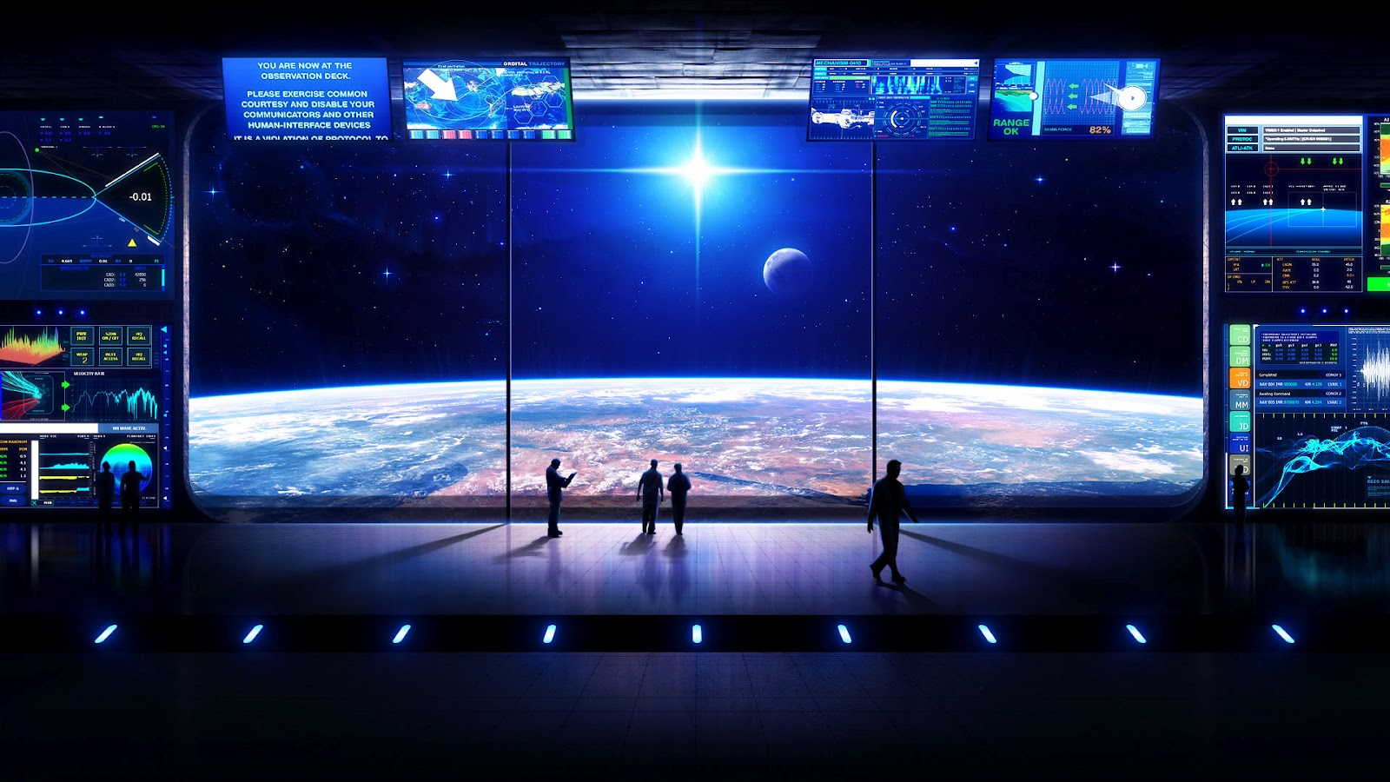
SCIENCE FICTION AND ANTICIPATION
A contribution to futures studies and foresight practices
ROBERTO PAURA

Slide 2
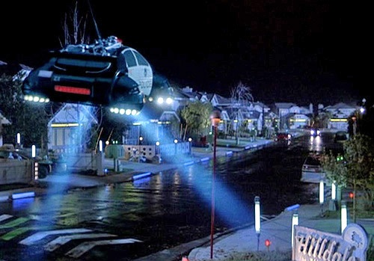
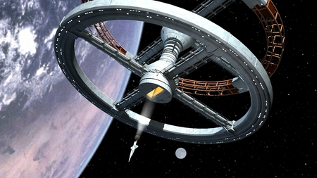
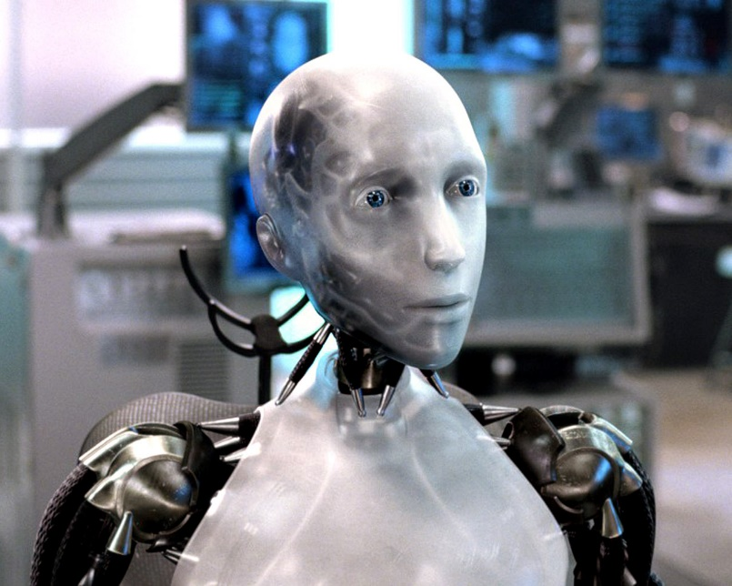
Science Fiction does not predict the future…
«A general myth among laymen is that, somehow, the chief function of a science fiction writer is to make predictions that eventually come true».
(Isaac Asimov)
After all, there are no androids like the ones predicted by Asimov, in 2001 there weren’t basis on the Moon or space hubs, as well as in 2015 we do not drive flying cars.
1st International Conference on Anticipation – University of Trento, 7 November 2015

Slide 3
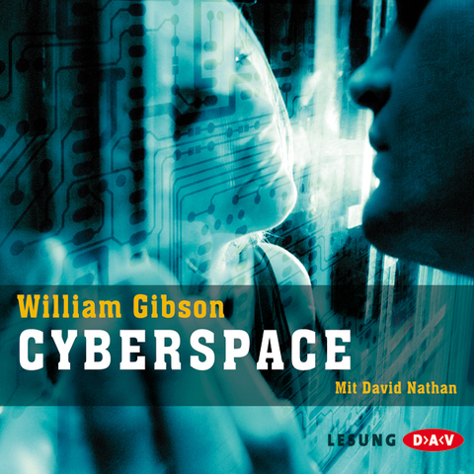
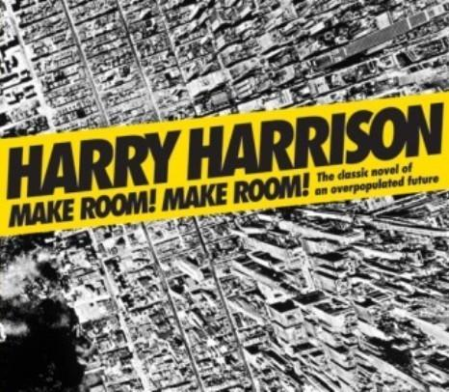
… Science Fiction anticipates likely futures.
«The thing to keep in mind is that I’m not actually predicting the future. I’m generating scenarios. And because I’m a fiction writer and not really a futurist… I’m not actually saying this is what we’re going to look like».
(William Gibson)
Anticipating likely futures implies the possibility for us to avoid worst-case scenarios by changing current trends.
1st International Conference on Anticipation – University of Trento, 7 November 2015

Slide 4
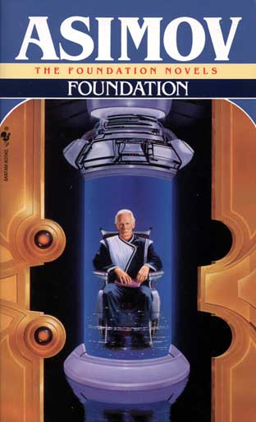
Science Fiction and Foresight: a close relationship
Asimov’s Psycohistory had a strong influence on many social scientists and pushed toward a more scientific approach to the understanding of society.
Paul Krugman
RAND Corporation as a first attempt to lead the progress of US through foresight methdologies.
The science of Complex Systems combines mathematics and sociology to understand social phenomena, as psychohistory does.
Joseph Tainter’s theories on the collapse of complex societies.
Peter Turchin’s clyodinamics is just another step into the quantitative history (established in 1960s).
Sociophysics.
1st International Conference on Anticipation – University of Trento, 7 November 2015

Slide 5
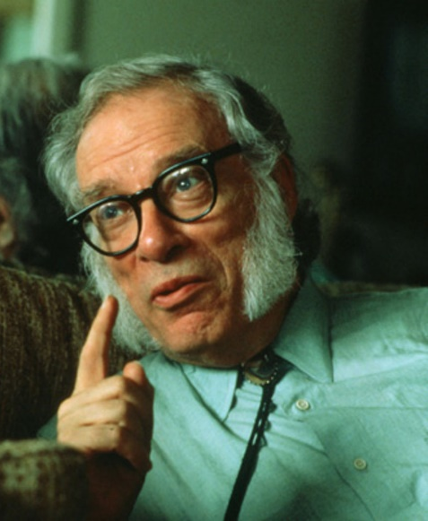
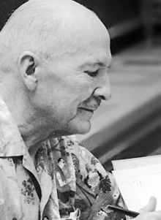
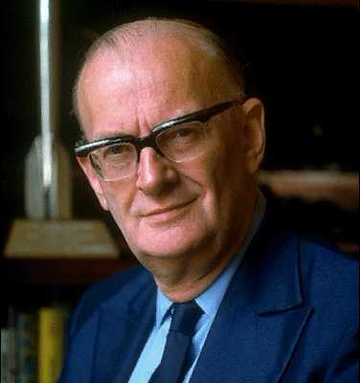
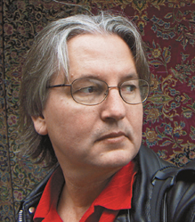
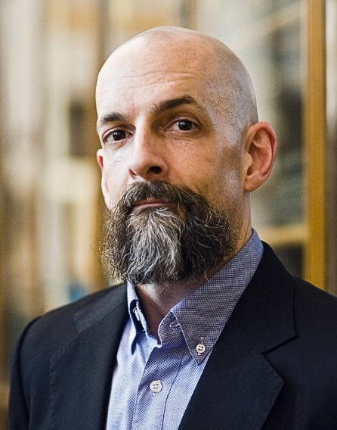
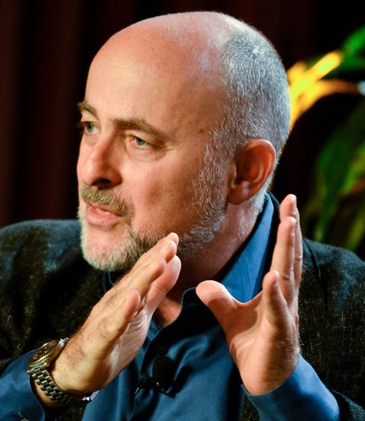
Science Fiction and Foresight: a close relationship
A number of SF writers worked or work as foresight consultants for companies and governmental agencies.
Isaac Asimov
Robert Heinlein
Arthur C. Clarke
Bruce Sterling
Neal Stephenson
David Brin
1st International Conference on Anticipation – University of Trento, 7 November 2015

Slide 6
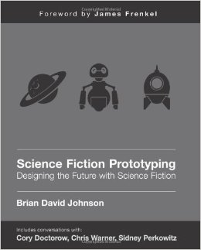
Science Fiction in foresight practice
Science Fiction Prototyping (SFP)
Developed by Brian David Johnson at INTEL, as a method for scientists and engineers to support product innovation.
Imagination Workshop: combining new emerging technologies with imagination and creativy for building the vision of future business.
Participants create a fictional future scenario as a framework for the new technology and extrapolate its possible effects on future society.
It’s just a vision of the future, not based (or only partially based) on concrete numbers or statistics.
1st International Conference on Anticipation – University of Trento, 7 November 2015

Slide 7
Science Fiction in foresight practice
SFP in practice: the Emerge event
Emerge: Artists and Scientists Redesign the
Future, Summer 2012, Arizona State University.
Three days, nine workshops, 700 participants to
produce fictional future scienarios.
The works start with presentations about
emerging technologies, designed to foster
reflections about the issues of sustainability, ethics,
justisce, in order to interrogate the desiderability and implications of these technologies.
The whole process is based on the principle of anticipatory governance, aimed to «collectively imagine, critique, and thereby shape the issues presented by emerging technologies before they become reified in particular ways».
1st International Conference on Anticipation – University of Trento, 7 November 2015

Slide 8
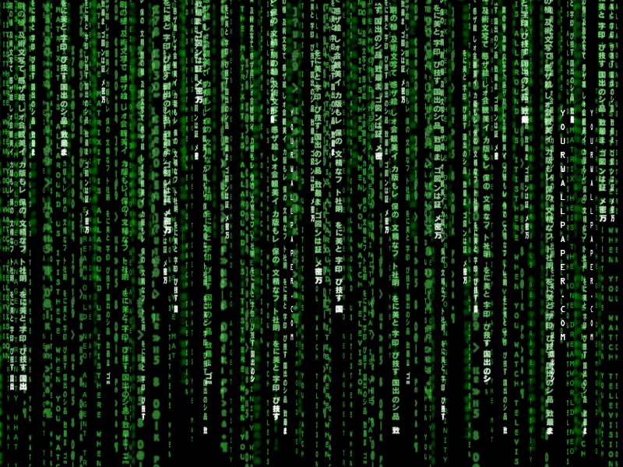
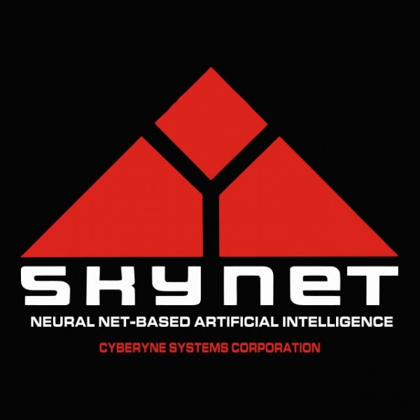
Science Fiction in foresight practice
A tendency for dystopian futures?
«Interestingly, five of the nine completed prototypes involved an omnipresent grid of computation that (mis)managed the protagonists’ lives in some important way, as a source of income, identity, or even morality [Fig. 2]. In the course of the story, the network either crashed or was subverted, and the protagonists were forced to return to an authentic human identity. These common themes may have reflected the anxieties of the authors. All workshop participants were knowledge workers associated with the university, who spend an immense amount of time with computers. This amount of time spent, as well as constant pressure to share more and more information to customize and improve the user experience, demands a kind of intimacy between humans and computers». (Burnam-Fink, 2015)
1st International Conference on Anticipation – University of Trento, 7 November 2015

Slide 9
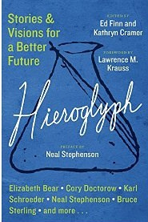
Science Fiction in foresight practice
The Hieroglyph Project
A project promoted by Arizona State University and led by SF writer Neal Stephenson. Twenty leading thinkers, writers, and visionaries produce fictional scenarios of “techno-optimism”.
«What science fiction stories—and the symbols that they engender—can do better than almost anything else is to provide not just an idea for some specific technical innovation, but also to supply a coherent picture of that innovation being integrated into a society, into an economy, and into people’s lives. Often, this is the missing element that scientists, mathematicians, engineers, and entrepreneurs need in order to actually take the first real steps towards realizing some novel ideas».
1st International Conference on Anticipation – University of Trento, 7 November 2015

Slide 10
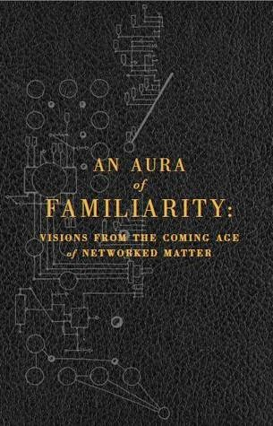
Science Fiction in foresight practice
An Aura of Familiarity: Visions from the Coming Ange of Networked Matter
A project promoted by the Institute for the Future in 2013: six leading SF writers write short stories on the coming revolution represented by the Internet of Things. The scientific framework is provided by IFTF’s Technology Horizon Program.
In a first phase, workshops and interviews with scientists, engineers, entrepreneurs, and designers are conducted, along with a scanning of science and technology journals. In the second phase, «we asked these writers to envision a world where humans have unprecedented control of matter at all scales, and to share with us a glimpse of daily life in that world. It was a process meant to make the future tangible».
1st International Conference on Anticipation – University of Trento, 7 November 2015

Slide 11
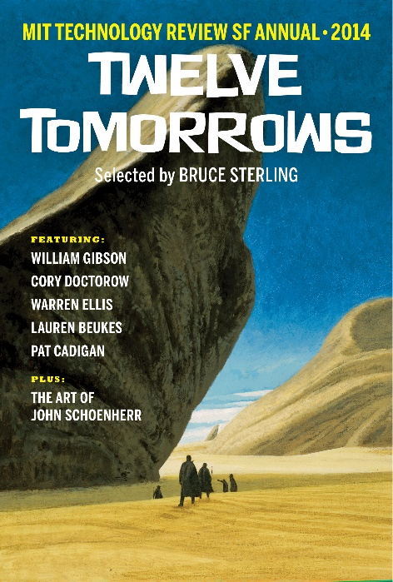
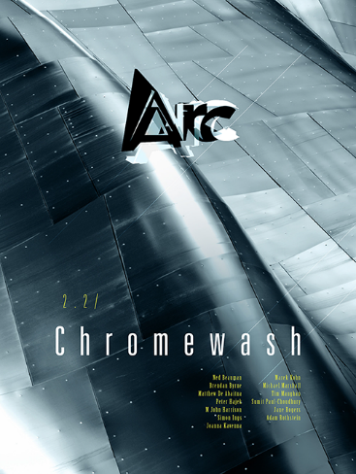
Intersections beteween SF and FS (Futures Studies)
Twelve Tomorrows
A special annual issue of MIT Technology Review with SF stories inspired by the real-life breakthroughs covered in the magazine.
Futures
An anthology that collects every year the stories and visions published in «Futures», Nature’s science-fiction weekly column.
Arc
Subtitled «Futures & fiction», a bimonthly magazine from the makers of New Scientist, with SF stories and articles on future scenarios.
1st International Conference on Anticipation – University of Trento, 7 November 2015

Slide 12
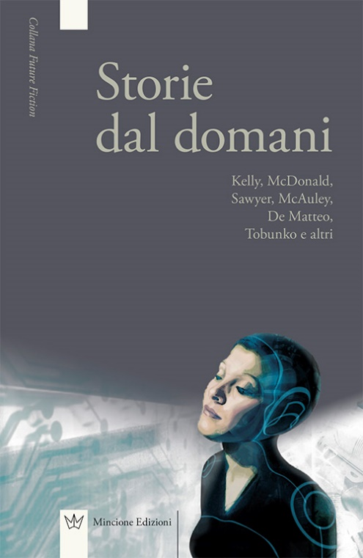
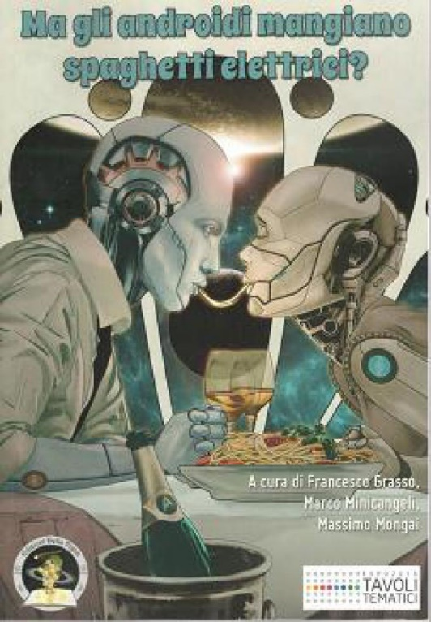
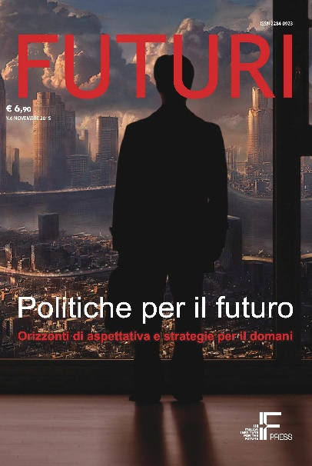
Intersections beteween SF and FS (Futures Studies)
Storie dal domani
A selection of twelve futures imagined and written by 9 SF writers from all over the world, translated in Italian by Future Fiction publishing.
Ma gli androidi mangiano spaghetti elettrici?
An anthology related to Expo 2015, collecting Italian SF stories on the future of food (Della Vigna publishing).
Futuri and more…
Each issue hosts a story of speculative fiction. In March 2016 an anthology with 6 brand new SF stories about the future will be published.
1st International Conference on Anticipation – University of Trento, 7 November 2015

Slide 13
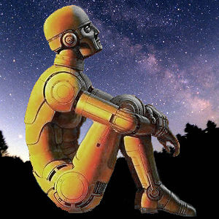
What are the advanteges of SF for social foregisht?
«What both science fiction and the futures workshop have in common is some kind of immersion of the reader or participant in imagined future worlds. The difference here is that science fiction writers will often write about dystopias, future worlds no one would want to live in, while futurist workshop facilitators move workshop participants swiftly on from doomsday talk. Science fiction writers may intend a dire warning for humanity, if trends continue; or they may also be caught in the narrative conventions of drama, character, action, and the happy/unhappy ending. Futurist facilitators see talk of doom as talk that is in danger of reaching some kind of closure in defeatism, and thus potentially destructive of group dynamics». (Rosaleen Love, 2001)
In brief:
A unique ability to anticipate consequences or social implications
of scientific or technological breakthroughs.
A natural tendency for perspective visions.
The possibility to use SF for outreach puroposes.
1st International Conference on Anticipation – University of Trento, 7 November 2015

Slide 14
Science Fiction as anticipatory fiction
Overpopulation
In 1968 two major books on this issue appeared: Paul R. Ehrlich’s essay The Population Bomb and John Brunner’s novel Stand on Zanzibar.
But Harry Harrison’s Make Room! Make Room! was published in 1966.
1st International Conference on Anticipation – University of Trento, 7 November 2015

Slide 15
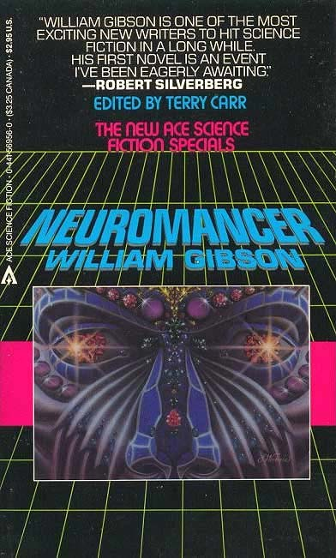
Science Fiction as anticipatory fiction
Cyberspace
In 1983, the ARPANET migrates to TCP/IP, and the new protocols at the basis of modern Internet were permanently activated.
In 1984, William Gibson’s Neuromancer introduces the idea of cyberspace as a virtual dimension at the core of future Internet.
1st International Conference on Anticipation – University of Trento, 7 November 2015

Slide 16
Science Fiction as anticipatory fiction
The case of climate fiction
A growing interest among SF writers on the issues related to climate change. Again, SF writers can anticipate the social implications of a scientifc phenomenon. While reports like the ones of IPCC rely on data and scientific facts, climate fiction has the advantage to transform forecasts in immersive future worlds where readers can «touch» the consequences of climate change better that through statistics and graphs.
1st International Conference on Anticipation – University of Trento, 7 November 2015

Slide 17
Science Fiction as anticipatory fiction
The case of climate fiction
The Imagination and Climate Futures Initiative at Arizona State University «explores how climate fiction shapes our imagination, how it relates to climate science and how it might affect social and political life. What is the nature of imagination? How do art and science inform our imagination about climate futures? What is the relationship between climate fiction, the imagination and political decisions and behavior in response to climate change?»
The Climate Fiction Short Story Contest at ASU is judged by Kim Stanley Robinson, award-winning author of many foundational works in climate fiction.
1st International Conference on Anticipation – University of Trento, 7 November 2015

Slide 18
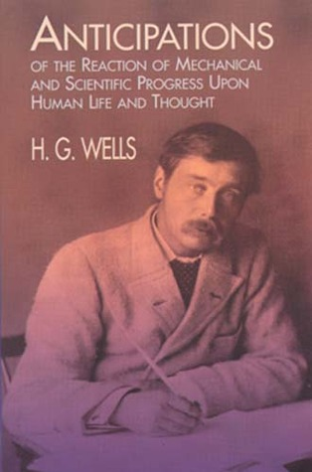
Science Fiction as anticipatory fiction
Anticipatory fiction?
In France → Anticipation, a subgenre of science fiction whose stories are set in a near or distante future.
In Italy → Narrativa d’anticipazione. Under this definition, a lot of international speculative novels appeared in Italy among 1973 and 1989, published by Nord.
In English literature → H.G. Well’s Anticipations (1902) «was the first comprehensive and widely read survey of future developments in the short history of predictive writing» (I.F. Clarke). Wells wasn’t just one of the funding fathers of science fiction, but also one of the first futurists. At the Royal Institution in that same year, during his lecture The Discovery of the Future, he called for a new science for the «knowledge of the future».
1st International Conference on Anticipation – University of Trento, 7 November 2015

Slide 19
References
Love Rosaleen (2001). Robot futures: science fiction and futures studies methodologies in action, Futures 33.
Wu Hsuan-Yi (2013). Imagionation workshops: An empirical exploration of SFP for technology-based business innovation, Futures 50.
Davies Sarah R. et al. (2015). Studying Emerge: Findings from an event ethnography, Futures 70.
Burnam-Fink Michael (2015). Creative narrative scenarios: Science fiction prototyping at Emerge, Futures 70.
Johnson Brian David (2011). Science Fiction Prototyping: Designing the Future with Science Fiction, Morgan & Claypool, California.
Finn Ed & Cramer Kathryn eds. (2014). Hieroglyph: Stories and Visions for a Better Future, William Morrow, New York.
Pescovitz David ed. (2013). An Aura of Familiarity: Visions from the Coming Age of Networked Matter, Institute for the Future, Palo Alto, California.
1st International Conference on Anticipation – University of Trento, 7 November 2015

