Slide 1
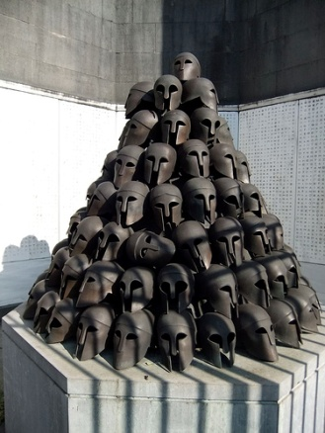
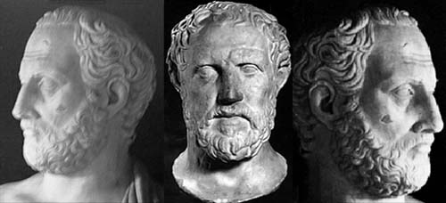
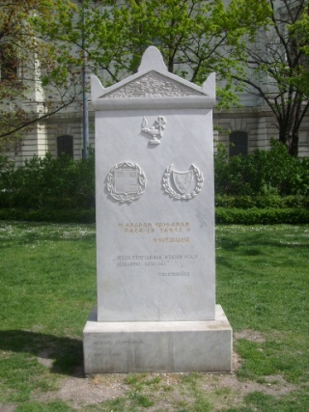
Thucydides and the Classical Foundations of Anticipation
Neville Morley (neville.morley@bris.ac.uk)

Slide 2
Thucydides, c.460-c.400 BCE
1.1: Thucydides of Athens wrote the war of the Peloponnesians and the Athenians, how they waged it against each other. He began writing at its very outset, in the expectation that this would be a great war and more worthy of account than any previous one. He based this judgement on the grounds that both sides came into the war at the height of their powers and in a full state of military readiness; and he also saw that the rest of the Greek world had either taken sides right at the start of was now planning to do so…
Narrates events of 431-404, the ‘Peloponnesian War’ that ended with Athens’ defeat by the Spartans.
Does not use the term historie adopted by predecessor Herodotus, but understood by most readers to be a kind of historian – if not indeed the first truly critical, even ‘scientific’, historian.
Second tradition of reception, beginning with Hobbes (“the most politic historiographer that ever writ”) sees rather as pioneering theorist.

Slide 3
Thucydides’ Claim to Usefulness
1.22.4: Perhaps the absence of fable in my work may make it seem less easy on the ear; but it will have served its purpose well enough if it is judged useful by those who want to have a clear view of what happened in the past and what – the human condition being what it is (kata to anthropinon) – can be expected to happen again some time in the future in similar or much the same ways. It is composed to be a possession for all time, not just a performance-piece for the moment.
Key claim is interpreted in significantly different ways, based partly on different translations and partly on different disciplinary assumptions.
‘Human nature’ as cause of repetition of events: corresponds to universal principles or laws of human behaviour, excluding culture and historical context. Events are predictable because humans/states are.
‘Human condition’ as cause of recurrent tendencies in human affairs: not reductionist or deterministic. Events are not predictable but can be understood on the basis of knowledge and understanding of past.

Slide 4
The ‘Thucydides Trap’
“The Greek historian’s metaphor reminds us of the attendant dangers when a rising power rivals a ruling power—as Athens challenged Sparta in ancient Greece, or as Germany did Britain a century ago.” (= 1.23.6)
Graham Allison: ‘The Thucydides Trap: Are the U.S. and China Headed for War?’ The Atlantic, September 2015: http://www.theatlantic.com/international/archive/2015/09/united-states-china-war-thucydides-trap/406756/

Slide 6
Learning from Past Events? 1
1.76.2: There is nothing remarkable or contrary to normal human behaviour in what we have done, just because we accepted an empire when one was offered and then declined to let it go, overcome by these strongest of all motives – honour, fear and self-interest. Nor were we the first to take this course but it has always been established practice for the weaker to be ruled by the stronger.
5.89: You understand as well as we do that in the human sphere judgements about justice are relevant only between those with an equal power to enforce it, and that the possibilities are defined by what the strong do and what the weak accept.
Mainstream political science and international relations tradition seeks to extract general principles and covering laws from account of past events, assumed to be basis for prediction of future.
Ascribes statements of characters in account to Thucydides himself, taken out of context; ignores role of chance and complexity in account.

Slide 7
Learning from Past Events? 2
3.82.4-5: Men assumed the right to reverse the usual values in the application of words to actions. Reckless audacity came to be thought of as comradely courage, while far-sighted hesitation became well-disguised cowardice; moderation was a front for unmanliness; and to understand everything was to accomplish nothing… The troublemaker was always to be trusted, one who opposed him was to be suspected.
Hobbes, ‘To the Readers’: Look how much a man of understanding might have added to his experience, if he had then lived a beholder of their proceedings, and familiar with the men and business of the time: so much almost may he profit now, by attentive reading of the same.
Other traditions focus on analogy: Thucydides’ account reveals certain tendencies or latencies, how people and states are likely to respond to given situations. Deliberately presented as exemplary?
Limited value in predicting specific events, but expand understanding of complexity. Reading is itself an education in interpreting events.

Slide 8
Understanding Anticipation
6.16.2: The Greeks had previously expected our city to have been exhausted by warfare, but they actually came to over-estimate its real strength because of the impressive presence I put up at Olympia… Such an achievement also adds to the sense of our underlying power.
6.17.4: It is unlikely that a rabble of this kind will be of one mind in responding to any proposal or will act with a common purpose. More probably, each of them would come over to us individually if they were attracted by what was said, especially if they are in a state of conflict, as we understand them to be.
Recurring theme in Thucydides’ account: failures of anticipation and understanding, tendency to over-estimate own strength and under-estimate that of enemy, role of hope and other emotions in influencing decisions. Explores range of cognitive traps; beliefs v. reality.
Emphasis on difficulty of acquiring genuine knowledge, and tendency to accept ideas without critical thought. Aims to teach critical thought?

