Slide 1
Why Establishing the Discipline of Anticipation is a Necessary Condition for More Effective Strategies for Achieving Human Resilience
Riel Miller

Slide 2
Change in the conditions of change
Embedding forecasting in foresight in anticipation belongs to an illusion like the one Roberto showed us – imagine anticipation not just as a way to improve forecasting & foresight for action but as a way to create a new context for the relationship between being and becoming in our fundamental sensing and sense-making systems.
Being anti-utopian isn’t enough.

Slide 3
If you over esteem great men, people become powerless. If you overvalue possessions, people begin to steal. The Master leads by emptying people's minds and filling their cores , by weakening their ambition and toughening their resolve. He helps people lose everything they know, everything they desire, and creates confusion in those who think that they know. Practice not-doing, and everything
will fall into place. Lao Tzu, Tao Te Ching, Chap. 3

Slide 4
What are we trying to do? The challenge of making sense of emergence in all its forms
Discontinuity
Valorizing the past
Experiments and sense making that seek to understand the links between old systems and novel systems - complexity between (retrofit strategy)
Discovery/Creation
Experiments and sense making that seek to invent new logics for new systems – not-doing & improvisation – surf complexity
(exogenous novel change)
Unprecedented
Improvisation
Preparatory
Reactive
Reform
Experiments and sense making that seek solutions to problems within existing systems – mastering complexity within
(endogenous change )
Adaptation
Experiments and sense making that seek to understand the links between novel systems and old systems - complexity between (transition strategy)
Continuity

Slide 5
Aspects of changes in the conditions of change – here and now
Freedom as a capability
Hubris of the species – barbarism of thought unable to sense and make sense of complexity – heroic ex-post agency
Negotiating shared sense-making: openness, trust, transparency – ‘the semantic web’
Learning – from ‘push’ to ‘pull’, preparation to revealing ignorance
Innovation – as “ontological expansion”
Agency and responsibility within the assemblage – parts unequal to whole, identity not just relative
Diversification through ease of birth, death, entry and exit
Search as distinct from choice
Democracy as knowing before choice
Uniqueness, specificity, ephemerality versus generalisation, common denominators, aggregation, duration

Slide 6
A few questions
Why assume the permanency of 19th century institutions?
Schooling & university hierarchy
Nations and nationalism
Corporate form of organization & wage labor
Statistics as aggregation & common denominators
Science as certainty – technology & engineering
Decision-making as power to colonize the future – executive authority state & firm, administration – command and control

Slide 7
The problem with the future
Reinforces:
Fear of uncertainty
Bias to seeking path dependency
Fetishism of immortality
Pre-occupation with endogenous continuous improvement – reform
False sense of temporality of change – seeking permission to not forecast, to liberate the imagination
Why?
Foresight methods are mostly limited to one view of how to use the future – for preparation and planning - closed.
Rarely imagining other conceptions of agency.
This is a formula for perpetuating the hold of past thinking on the present – to not escape mindsets that generate humanity’s track record of colonization in every domain.

Slide 8
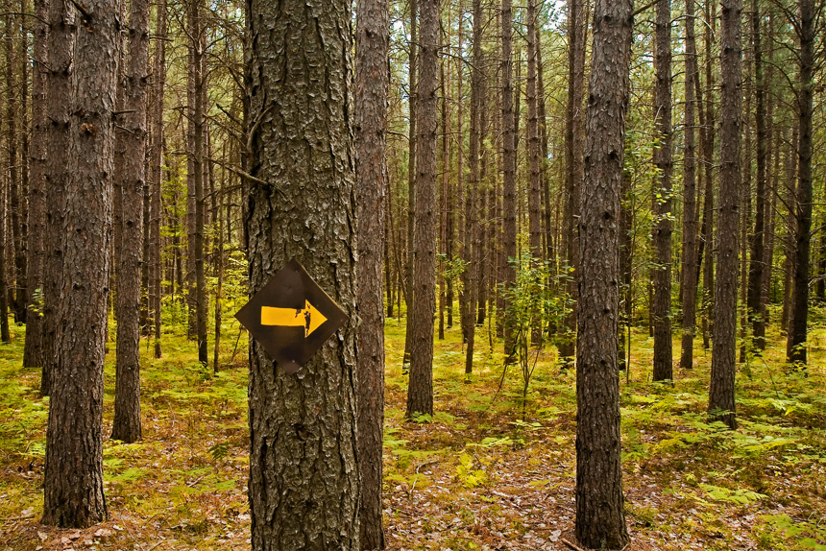
How do we know what we do not know? A role for social science…
What we see and do in the present depends heavily on what we imagine in the future.
Use the future to discover the present – to grasp novelty, emergence, systemic boundaries.

Slide 9
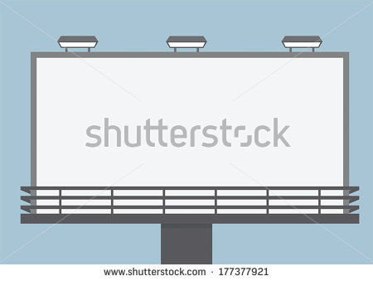
What is Future Literacy?

Slide 10
Futures Literacy
Futures Literacy is the capacity to tell anticipatory stories using rigorous imagining based on sharing depth of knowledge from across the community. FL is a way of internalizing the constant development of our understanding of the potential of the present and of changing anticipatory assumptions.

Slide 11
Three basic building blocks of Futures Literacy:
FL 1: Anticipation as a basic attribute of reality
FL 2: Conscious forms of anticipation – three dimensions
FL 3: Rigorous imagining – ‘meta-framework’ for the efficient enlargement of the knowable (before actionable)

Slide 12
FL 1. Anticipatory Systems and Processes
The future only exists in the present as anticipation.
There are many types of anticipatory systems and processes
Distinguishing the “what” and “how” of the future – guiding the use of tools.

Slide 13
FL 2. Dimensions of the potential of the present – how we use our imagination
Closed systems:
Preparation
Optimization
Open systems
Sensing and making sense of difference, emergence – naming unknown unknowns.

Slide 14
FL 3. Rigorous imagining
Collective intelligence knowledge creation, adding uniqueness to generality
Exposing anticipatory assumptions, system boundaries – data of human anticipation
Reframing & new questions – search before choice

Slide 15
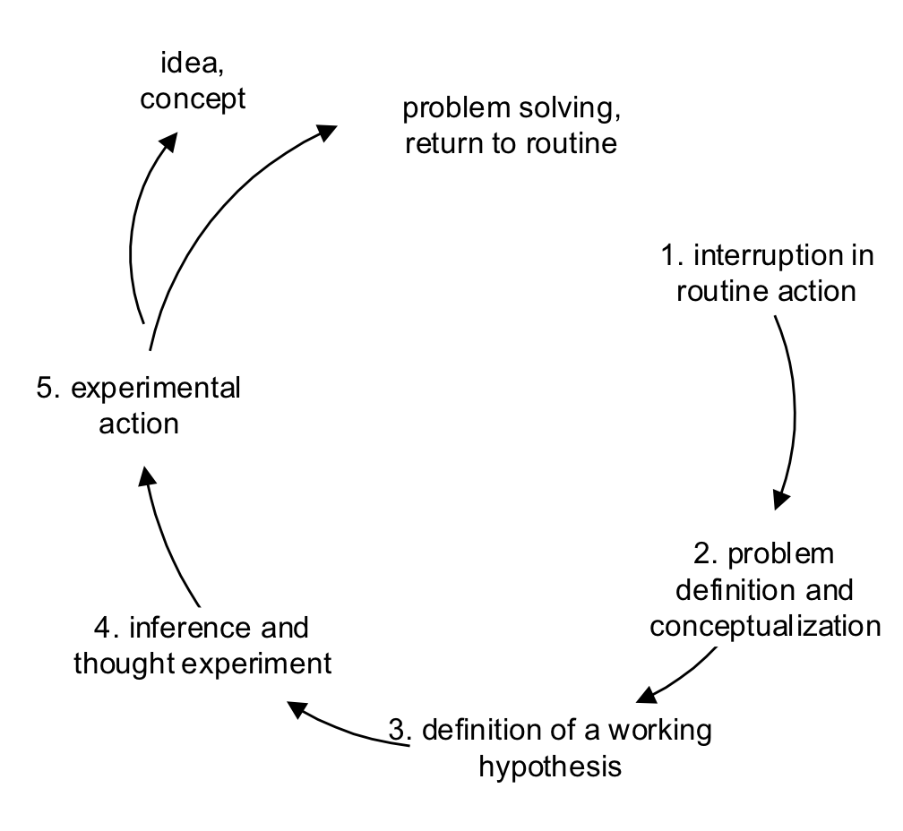
Learning pull
Seeking to know when you want to know: experimentalism
Engeström's learning cycle., in Ilkka Tuomi, The Future of Learning in the Knowledge Society: Disruptive Changes for Europe by 2020. IPTS 2005

Slide 16
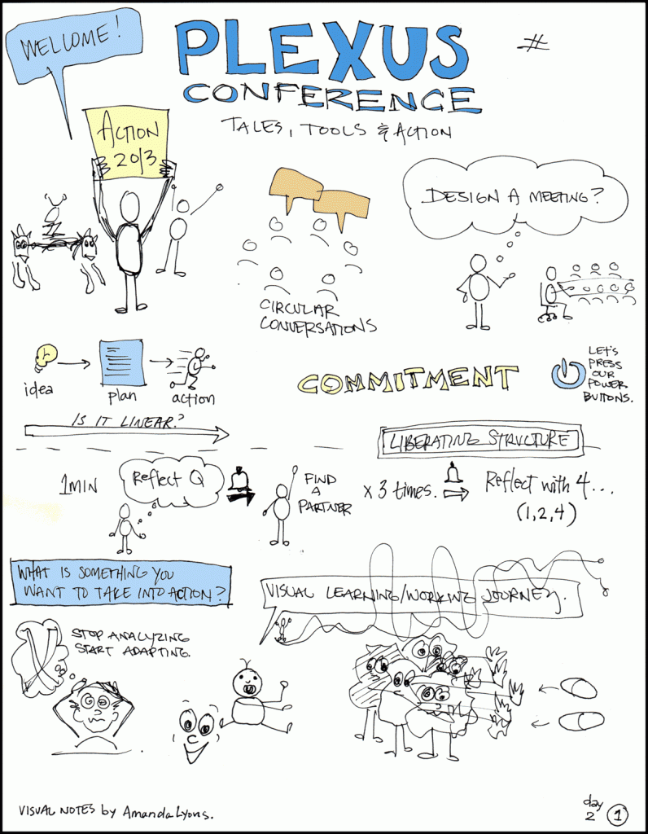
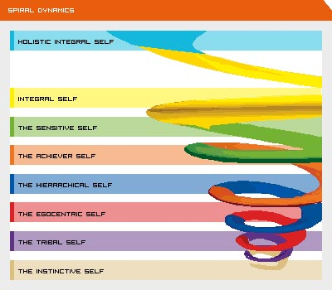
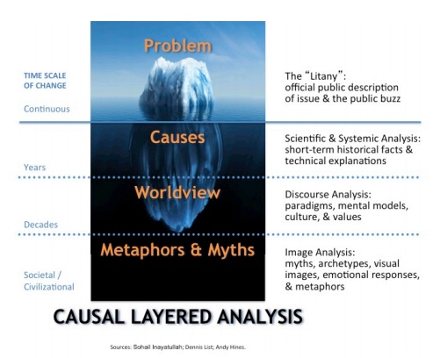

Slide 17
Using collective intelligence: sense making as learning
New Questions – expanding what makes sense – but it is not choice, choice is closure, commitment to one set of anticipatory assumptions
Reframing – question and invent anticipatory assumptions – models for describing the imaginary future
Provocation – inkling of ignorance
Tacit to explicit – reveal existing anticipatory assumptions, end of history illusion

Slide 18
Meta design for an FL KnowLab – tailored locally
Level 1
Temporal awareness, values, expectations – feeling the future, discovering ignorance
Level 2
Rigorous imagining – reframing
Level 3
New anticipatory assumptions - asking new questions

Slide 19
Rigorous Knowledge Creation: Action Research The Scientific Method Applied to the Uniqueness of the Future in the Present
Narrative Capacity
Capacity to Reframe
Collective Intelligence (interactive sense making)

Slide 20
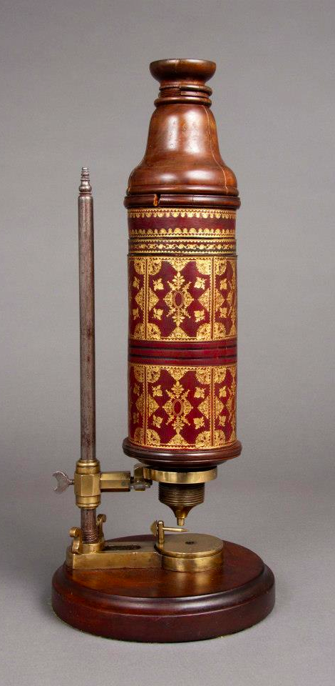
In the late 17th Century Anton van Leeuwenhoek discovered bacteria.
The microscopes he invented revealed invisible worlds. But it took another two centuries to make sense of this discovery.

Slide 21
Sources Guiding the Design of Processes for Becoming Futures Literate
Theory of anticipation: criteria for using the future
Theory of collective intelligence knowledge creation: making sense of specificity
Taken together we have the Discipline of Anticipation and the capacity to use the future as Futures Literacy

Slide 22
Forthcoming Publication: Transforming the Future: Anticipation in the 21st Century
“Transforming the future: Anticipation in the 21st Century” offers convincing evidence that the ways that people all around the world are using the future to understand the present are changing. These innovations in the theory and practice of anticipation are occurring because humanity is moving to integrate complexity and uncertainty into what we see and do.
The research presented in this book shows that it is only from the narrow viewpoint of closed systems planning that the richness of emergent novelty is an enemy.
Today, two powerful forces are changing how we perceive and take advantage of complexity, turning it from a threat into a resource. First is the desire to enhance the capability to be free and second is the growing appreciation of complexity that includes the inherently unknowable. People are experimenting and researching ways to enlarge and deepen their understanding of reality. This is a basic advance in the reach and relevance of science.”

Slide 23
Baku: Scoping Global Anticipatory Capacities, June 1, 2013
Paris: Knowlab Design Test Session “Scoping the Know-Lab: Tomorrow’s Knowledge, Creation Microscope” A Primer and Images, June 20-21, 2013
Brasilia: The Future of Science, 11-12 July, 2013
Sao Paolo: Changing the Way Universities Use the Future?, July 15, 2013
Chicago: The Future of Futurists, July 19, 2013
Oslo: Innovation as Learning, Knowing as Learning, Knowing as Science: Imagining a Universal Innovation Society in 2040, October 21-22, 2013
Bogota: Using the future to think about local labor markets, November 25-26, 2013
Rio de Janeiro: Imagining the Future of Science in Society, November 28-29, 2013
Paris: Imagining the Future of the Transition from “Youth” to “Adult”, January 13-14, 2014
Freetown: Youth & Rites of Passage in Sierra Leone, January 20-21, 2014
February 5-6, 2014, Munich: Imagining the Future of Sports in Society
Paris: Inhabiting Planet Earth 2100: Beyond Cities?, March 27-28, 2014
Calceta, Bahia de Caraquez, Monta: A Series of Future Literacy Knowledge Lab in Ecuador, April 26–May 1, 2014
Rangoon: Addressing the future of education in Myanmar?, May 2-3, 2014
Laoag City: Resilient Cities, Brighter Futures -A Forum-Workshop on Anticipatory Thinking and Strategic Foresight Methods for Sustainable City Futures, May 21-24, 2014
Johannesburg – All Africa Future Forum, May 26-28, 2014
Ottawa: The Future of Innovation Ecosystems in the Public Sector, June 4-5, 2014
Brasilia: Joint International Foresight Academy, November 16-21, 2014
Paris, L’Afrique de Demain ?, May 21, 2015
Rabat, Imagining Africa’s Future, June 25-26, 2015
Bangkok, Rethinking Education, September 1-3, 2015
Ulaanbaatar, The Future of Mongolia, September 20-October 2, 2015

Slide 24
The value-added of the Discipline of Anticipation
Science of generality
Statistics, patterns
DoA
Experimentalism
Inspiring & harvesting novelty
Managerialism
Preparation & planning
Science of specificity
21st C microscope – collective intelligence, action research

Slide 25
Walking on two legs
How to pursue a “better future” - reframing human agency:
Closed – what we prepare for (contingent futures); what we attempt to create (plan for)
Open – what we discover, revealing what we did not know we knew (new sense making) and inventing the unknowable
Towards a capacity to distinguish search from choice and to be less biased towards path dependency – colonizing the future – getting beyond the end of history illusion.
Notes:
http://3.bp.blogspot.com/-7ILonOKQ1gE/Th0Y2AxQIGI/AAAAAAAAAEg/jPJjXAv2Qbg/s1600/Great+Leap+Forward+03.jpg

Slide 26
Experimentalist leadership
“Society is now at a stage in history in which one pulse is ending and another beginning. The immense destruction that a new pulse signals is both frightening and creative. It raises fundamental questions about transformation. The only way to approach such a period, in which uncertainty is very large and one cannot predict what the future holds, is not to predict, but to experiment and act inventively and exuberantly via diverse adventures in living.”
C.S. “Buzz” Hollings, “Coping with Transformational Change”, Options, IIASA, Summer 2010

Slide 27
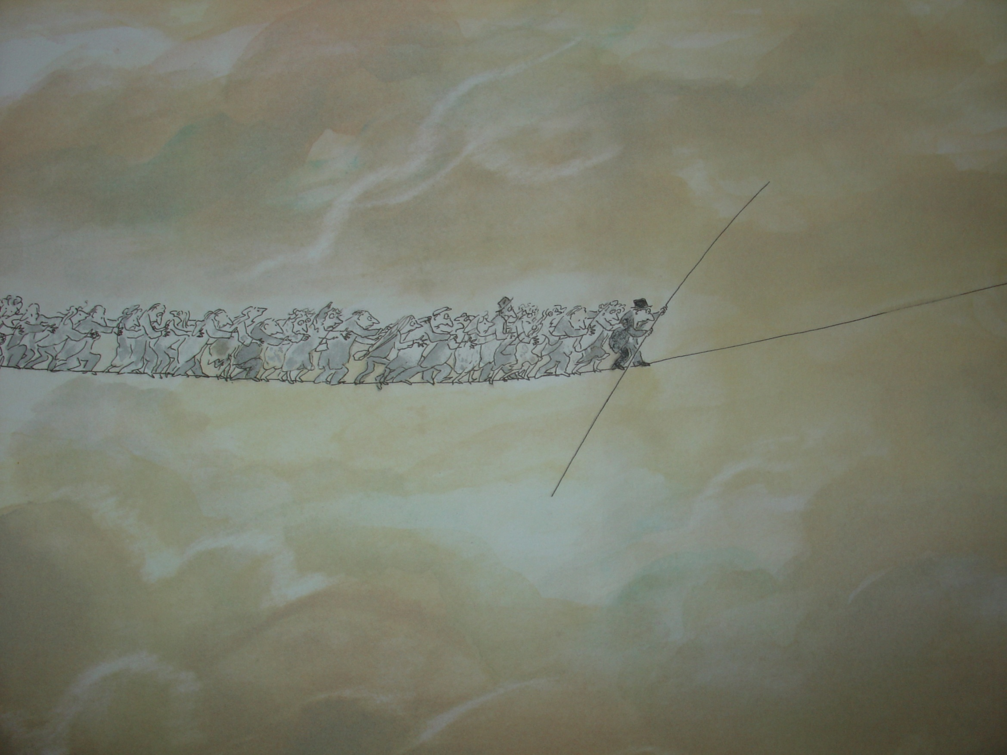
Thank you | Riel Miller r.miller@unesco.org
How we anticipate matters
It changes the present
Image: Sempe

