Slide 1
Education for Warp Speed: Anticipating the Future
WUC and WAAS offer a Post-graduate Course on
Future Education
IUC, Dubrovnik, September 21-23, 2015
By Garry Jacobs
CEO, World University Consortium
Conference on Anticipation, Trento – Nov. 5-7, 2015

Slide 2
Education abridges time
Education transmits to the next generation the cumulative knowledge acquired by countless past generations
EDUCATION ACCELERATES SOCIAL EVOLUTION
2
Notes:
Rediscovering Pythagorean theorem, Archimedes principle, Zero, decimals, double entry book-keeping, heliocentric universe, Newton’s laws of motion, X-Rays, Boyles Law, radiation, the Atom, Relativity & Quantum mechanics, the unconscious, the transitor, DNA

Slide 3
Conservative & Progressive Attributes
Orientation to the past – emphasis on past experience and knowledge that has already been acquired rather than what is yet to be discovered.
Learning from failures – consciousness of past errors and failures creates a greater willingness to challenge convention and explore new approaches
Awareness of change – reflection on past experience makes us much more conscious of how much has changed and generates anticipation of a different future
3
Notes:
We think much more about what has happened over the past 2000 years than what is likely to happen over the next 20
What lessons have we learned from our glance at the past that are applicable to the future? How to teach those lessons?

Slide 4
Triple Time Warp in Education
Instructors are educated in a previous generation by instructors educated in a generation prior to that
The instructors of today’s educators were educated by instructors educated during at the height of the Cold War, before the first oil crisis, birth of the environmental movement, the economic rise of Japan or the personal computer revolution
Instructors are teaching a generation after they acquired knowledge, during which knowledge has changed enormously
Many of today’s instructors were educated before the end of the Cold War, the breakup of the Soviet Union, the founding of the EU, the creation of the Internet, robotics, artificial intelligence or analysis of the human genome
The content of knowledge is changing so rapidly that what is taught today may be obsolete a few years from now.
How relevant is a 1995 MBA in financial markets to the computerized & globalized financial markets today or today’s economic theory to 2025?
4

Slide 5
Accelerating Social & Technological Trends
The quantum of information and speed of its multiplication continues to accelerate.
Just how much information can the human mind absorb? More importantly, how much emphasis on passive absorption of information is compatible with development of an active thinking mind?
Technology for dissemination of information makes access to facts and methods of analysis available everywhere instantaneously.
How far has the content of higher education evolved to reflect changes in access to information, since the time of the printing press, newspaper, radio, TV and internet?
Technology for educational delivery has evolved far beyond the level prevalent when the present system of was first established.
Compared with the evolution of other fields, how far have methods of education changed to reflect advances in technology since the founding of the University of Bologna in 1088?
5

Slide 6
Recent Trends in Education
Enormous quantitative expansion in demand and supply
Major increase in the quantum of information incorporated in the academic curriculum
Multiplication and fragmentation of disciplines into more and more specialized compartments
Increasing shift from general knowledge to discipline-specific expertise
But attention remains largely focused on past experience and past forms of knowledge rather than anticipation of the future
6

Slide 7
What is our time-frame?
“THE ONLY USE OF A KNOWLEDGE OF THE PAST IS TO EQUIP US FOR THE PRESENT.”
THE EVER PRESENT MOMENT
“The present holds within itself the complete sum of existence, backwards and forwards, the whole amplitude of time, which is eternity.”
Alfred North Whitehead
13

Slide 8
What should we teach & how much?
Facts that are multiplying exponentially
Information that is out-of-date even when it is taught
Thoughts derived by the correlation of information
Ideas that relate & integrate thoughts
Values as principles to guide accomplishment and growth
12

Slide 9
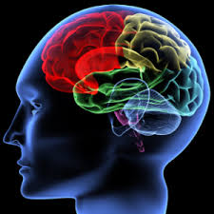
What faculties should we be developing?
Memorization
Observation
Multi-sensory capacities for learning
Multiple intelligences
Analytic thinking
Independent thinking
Imagination
Synthetic, holistic thinking
Integrated thinking

Slide 10
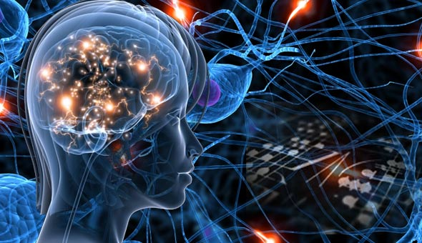
Creative Thinking
15

Slide 11
Types of Thinking
Analytic | Reductionism | Individuality
Synthetic | Systemic | Commonalty
Integrative | Unifying | Essentiality
16
Notes:
e.g. Character– Culture – Human Nature

Slide 12
Deep Thinking
All knowledge is based on a conceptual system (framework)
Education is build on progressive layers of conceptual systems
Since the framework is implicit, subconscious, taken for granted, it is extremely difficult to comprehend perspectives or solutions that lie outside it
Problems generated by the implicit premises of a conceptual framework persist until a new framework emerges – a new, more inclusive paradigm
We learn to embrace multiple paradigms once they are established
What we rarely learn is how to consciously identify the limiting premises of prevailing paradigms and consciously love to transcend them
The capacity to become conscious of conceptual limitations and overcome them is the essence of creative thinking
William Byers, Deep Thinking
18

Slide 13
Reconciling Contradictions
“The test of a first-rate intelligence is the ability to hold two opposed ideas in mind at the same time, and still retain the ability to function.”
F. Scott Fitzgerald
Great scientific discoveries unify apparently disparate or independent phenomena
Can it be taught?
13
Notes:
“Not setting truth against truth to see which will stand and survive, but completing truth by truth in the light of the one Truth of which all are the aspects.” LD 983
Genius
Deep thinking – William Byers – paradigm change – change in conceptual framework

Slide 14
New Paradigm in Education
PRESENT
Information-based
Compartmentalized
Abstract & Detached
Subject-centered
Mechanistic
Discipline-specific
Analytical thinking
Paradigm-specific
Professional
FUTURE?
Idea-based
Contextual
Life-centric & Value-based
Person-centered
Organic
Trans-disciplinary
Synthetic & Integrative thinking
Multi-paradigmatic
Personality & Individuality
14
Notes:
How economies work vs What is the goal of economy
Theoretical – economic theory, personality theories, philosophy, history – ideas for their own sake
Ideas for application in life
Multi-paradigmatic – teaches economy in context of politics, society and ecology

