Slide 1

Are we losing individual leadership potential in the current global trends?
Faris GAVRANKAPETANOVIC, MD, MBA, PhD, Fellow of WAAS
Bojan SOSIC, ABD
Trento, November 6, 2015

Slide 2
Globalization
Globalization includes processes that enable individuals to transcend various boundaries in ways that were unimaginable even decades ago, or at least to become aware of these boundaries. Man has become truly a being of information, and information knows no national or regional boundaries. Education has changed its face in line with the newly available resources, primarily the Internet.

Slide 3

“Global village”
Nowadays, one can instantly learn of most recent scientific discoveries such as those that much of that progress rests on, in most remote areas of the world. The 20th century has brought enormous changes to the world, turning it into McLuhan’s “global village”.

Slide 4
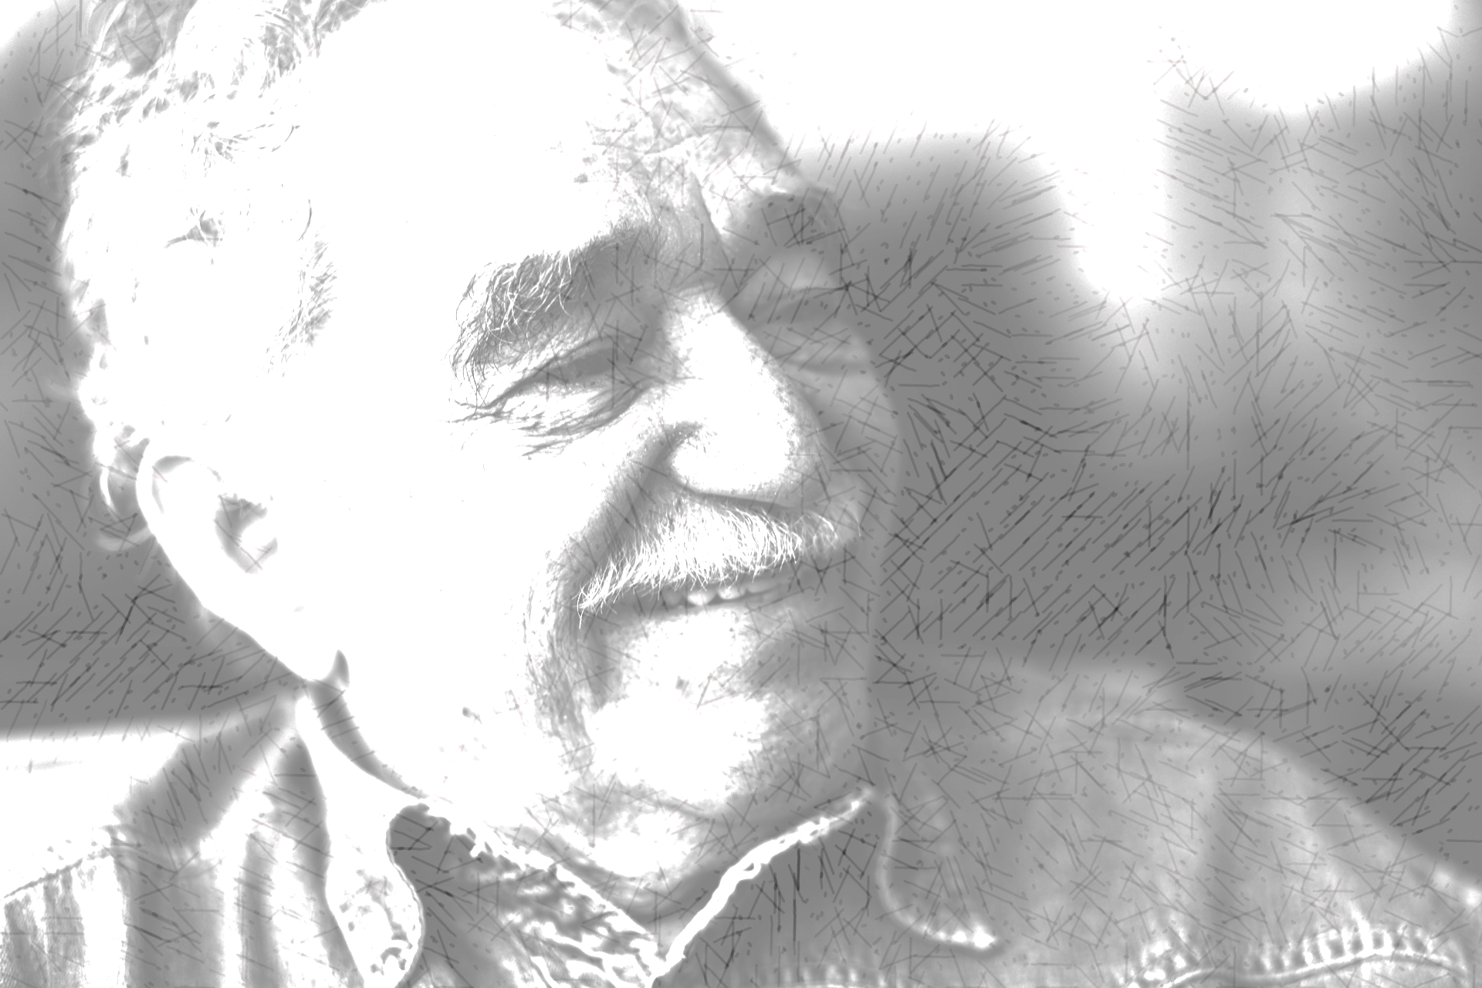
“Science has eliminated distance.”
It was science that brought the once distant parts of the world together, as brilliantly conveyed in a brief formula expressed by Gabriel Garcia Marquez in his One Hundred Years of Solitude, stating apodictically and with striking clarity, “Science has eliminated distance.”

Slide 5
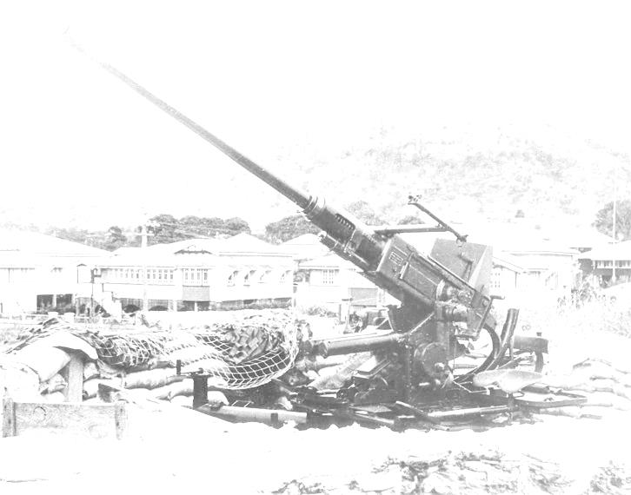
War as a driver of change.
The now global challenges called for global solutions, and it was during the World War II that a group of scientists joined their forces around a practical issue of automating automatic aiming and firing of anti-aircraft guns. Their work gave birth to the discipline of cybernetics, with a landmark paper:
"Behavior, Purpose and Teleology" (1943) by Norbert Wiener, Arturo Rosenblueth, and Julian Bigelow.

Slide 6

Prediction at the heart of cybernetics
Easily reminiscent of the practical motives of their collaboration in relation to automatic aiming, the authors provide graphic illustrations of different types of prediction,
  „[t]he cat chasing the mouse is an instance of first-order prediction; the cat merely predicts the path of the mouse. Throwing a stone at a moving target requires a second order prediction; the paths of the target and of the stone should be foreseen.“

Slide 7

Collaboration of minds
Nobert Wiener, a Professor of Mathematics at MIT, was a son of a Russian immigrant to the United States, Leo Wiener, a Professor of Slavic Languages and Literatures at Harvard University.
Arturo Rosenblueth was a Mexican physiologist working at Harvard with the father of American physiology, Walter Cannon, himself a friend of Wiener’s parents.
Julian Bigelow was a New Jersey born mathematician and electrical engineer.

Slide 8
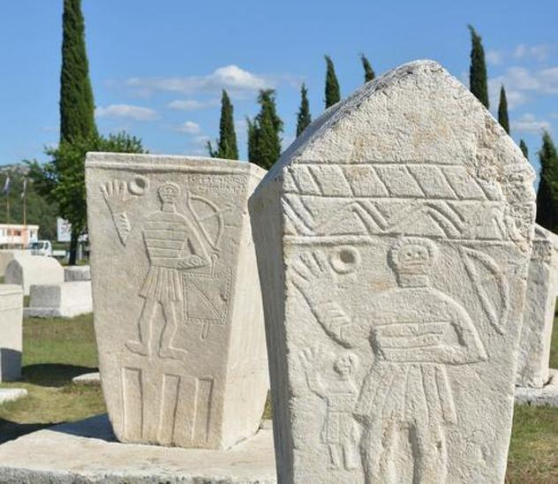
Favorable conditions.
The birth of cybernetics, or the science of “Control and Communication in the Animal and the Machine,” as Wiener briefly defined this discipline in the title of his book (1948), has had much to do not only with the practical need to improve artillery, but also with a confluence of favorable conditions in which ideas could be freely shared, in this instance, by a son of a Russian immigrant, a Mexican, and an American.

Slide 9
Migration – strengthening the supremacy of the West
Given the significance of cybernetics in the shaping of modern humanity, can we argue that the fact 18-year-old Leo Wiener immigrated to the United States, a man who eventually learned some 40 languages, his political convictions that kept him away from his homeland aside, ultimately – through his son – strengthened the supremacy of the USA and the West in general in the second half of the 20th century?
Rosenblueth chose to return to Mexico, but always remained a valued contributor in the American intellectual milieu.

Slide 10
Possibilities give birth to restrictions
It is clear how global or individual crises can give rise to actions and consequences that lead to some sort of progress in the long run, sometimes of global importance such as in the example how cybernetics was developed. But it so happens that “[w]e have modified our environment so radically that we must now modify ourselves in order to exist in this new environment. We can no longer live in the old one. Progress imposes not only new possibilities for the future but new restrictions” (Wiener 1954/1989).
Over the course of the second half of the 20th century, this progress has been operationalized in research funding modalities that have a significant toll in the research process itself.

Slide 11
Modern conditions of scientific work.
„If an agency decides, as one possible policy, to distribute the available money over more grants rather than to reduce the number of approved grants, these will not be substantial enough to employ staff and students, which will reduce efficiency and education. Or else, the applicant applies to other agencies. The shortage also entails a lack of venture capital, implying an immense pressure for immediate results or, put another way, a lack of patience, which will compromise long-term research projects at high risk. Just imagine: had Kant or Darwin been dependent on a three-year grant from a modern funding institution, the Critiques, or Origin of Species would never have been written. „ (Greger & Windhorst 1996)

Slide 12
Modern conditions of scientific work
„This shortness of breath also shifts research into easily doable directions […]. Finally, this development is accelerated by the requirements specified by funding agencies that “modern and highest standards” be used, often meaning the application of latest methodology and fostering method- rather than problem-oriented research.“
(Greger & Windhorst 1996)

Slide 13
Against the very nature of science.
Scientific work, the only thing that brought any serious progress to humanity as we know it, is today hampered by administrative practices and funding modalities that demand short-term thinking, chopping major projects into smaller ones that would fit the required funded periods of time, all against the nature of science itself. Wasting the time and capacities of researchers to project-oriented work, robs experts through opportunity cost. This sort of functioning deprives them of even otherwise scarce time and, of course, often also of financial resources.

Slide 14
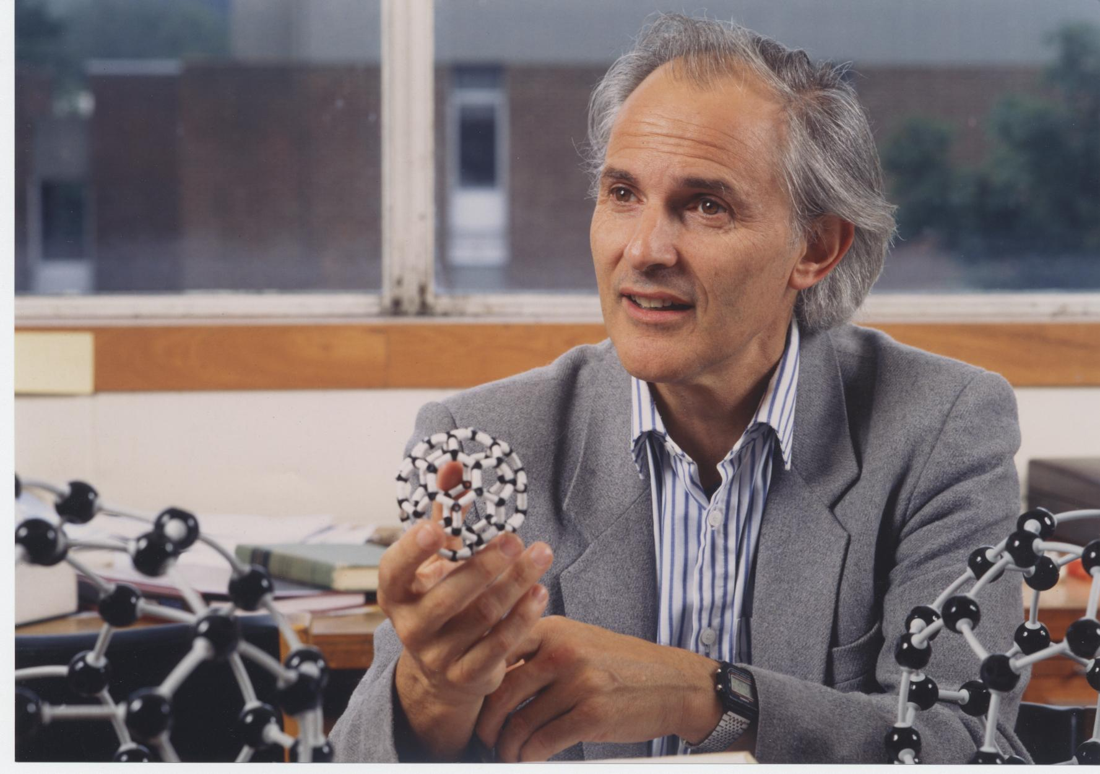
In search for money.
Migration of a Nobel prize winner from UK to USA seems like an obvious reason for concern, but how many scientists with outstanding potential are precluded from contributing to humanity just because they are yoked by restrictive immigration policies or bureaucracy-shaped calls for research funding proposals that evade both reality and the true nature of science?
(Figure: Sir Harry Kroto)

Slide 15
Globalization is turning us into – individuals
„One of the decisive features of individualization processes, then, is that they not only permit but they also demand an active contribution by individuals. As the range of options widens and the necessity of deciding between them grows, so too does the need for individually performed actions, for adjustment, coordination, integration. If they are not to fail, individuals must be able to plan for the long term and adapt to change; they must organize and improvise, set goals, recognize obstacles, accept defeats and attempt new starts. They need initiative, tenacity, flexibility and tolerance of frustration.“ (Beck & Beck-Gernsheim 2002)

Slide 16
Individualization
„Opportunities, dangers, biographical uncertainties that were earlier predefined within the family association, the village community, or by recourse to the rules of social estates or classes, must now be perceived, interpreted, decided and processed by individuals themselves. The consequences -- opportunities and burdens alike -- are shifted onto individuals who, naturally, in face of the complexity of social interconnections, are often unable to take the necessary decisions in a properly founded way, by considering interests, morality and consequences.“ (Beck & Beck-Gernsheim 2002)

Slide 17
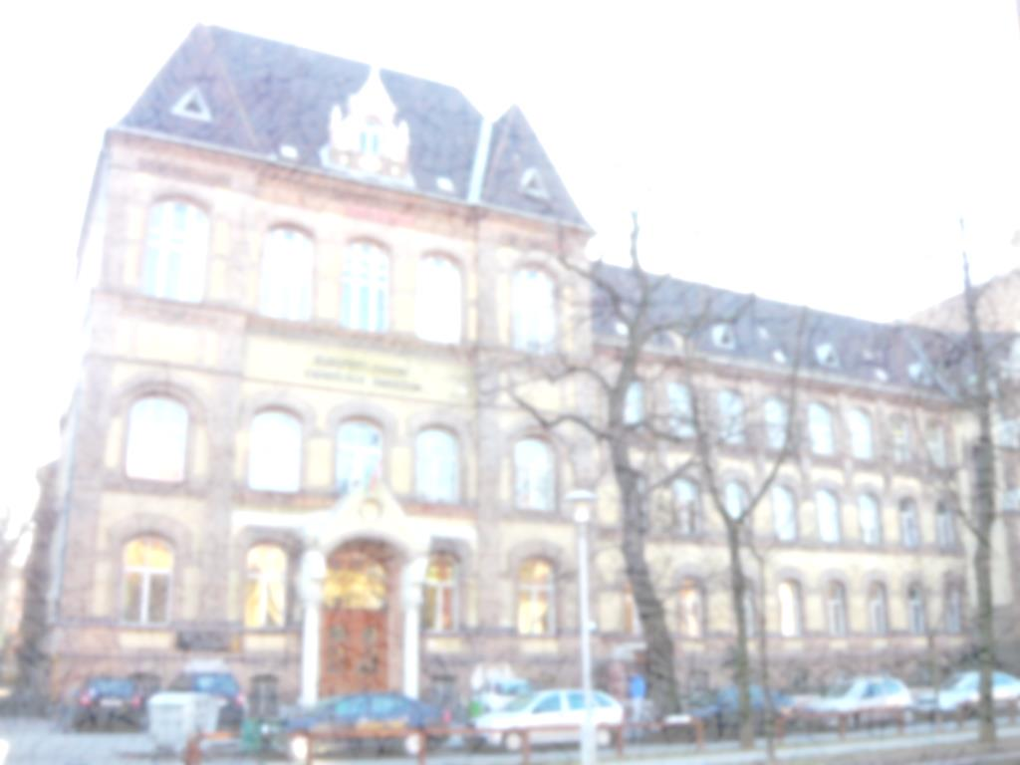
Striking asymmetries in opportunities.
While it is obvious that there are striking asymmetries when it comes to the opportunities of conducting actual scientific research in various parts of the world, education is obviously far less restricted by socio-economic circumstances.
A renowned example of the importance of education in shaping the minds of future world-class intellectuals is the "Fasori" Lutheran Secondary School in Budapest. It was attended by two Hungarian-born Nobel laureates, namely Eugene Wigner (Physics 1963) and John Harsanyi (Economic Sciences 1994).

Slide 18
One remarkable teacher and three remarkable students
Perhaps less known is a marvelous example of the Abraham Lincoln High School in Brooklyn, and its science clubs managed by Sophie Wolfe. This after-school program was attended by no less than three Nobelists: Arthur Kornberg (Physiology or Medicine 1959), Jerome Karle (Chemistry 1985), and Paul Berg (Chemistry 1980).
Ms. Wolfe was not a trained teacher, but maybe rather a sort of a natural master in the Socratic method of teaching: “Her official responsibility was to supervise the school supply room that stocked various materials (a variety of models, chemical equipment and microscopes) regularly used during science lectures. She also orchestrated and managed the so-called Biology Club, an informal group of student stalwarts that met most days after classes to pursue their interests in science.”

Slide 19

Example of Ms. Wolfe is surely worth remembering when we speak of individual potential, even if it serves merely as an inspiration for great achievements. Such examples lead to a conclusion that even when science can hardly be cultivated in a given environment due to poverty, education must not suffer from similar shortcomings.

Slide 20
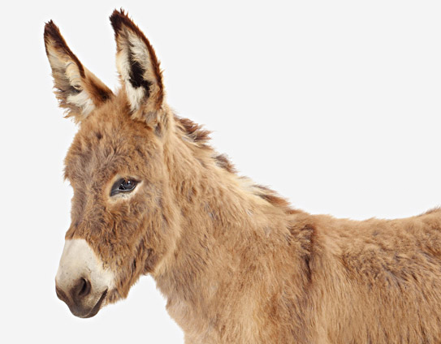
Magic and donkeys
The asymmetry of the world comes once more to mind through the words of Gabriel Garcia Marquez, whose character José Arcadio Buendía sums it up by saying,
“Right there across the river there are all kinds of magical instruments while we keep on living like donkeys.”

Slide 21
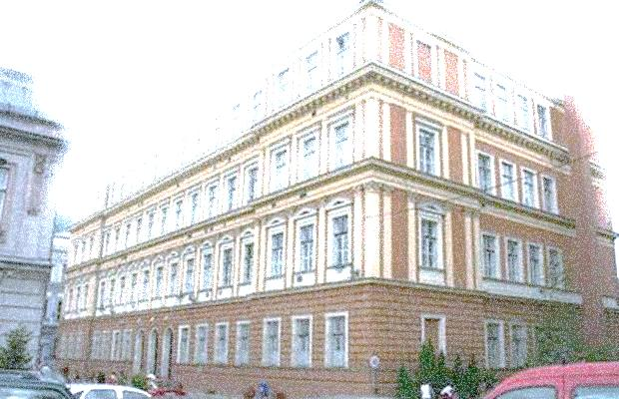
Bosnia
We can personally testify of the conditions that make our country – Bosnia and Herzegovina ranked 131st by its population size, but as high as 24th in the list of countries by Nobel laureates per capita. Both Bosnian Nobelists, Ivo Andrić (Literature 1961) and Vladimir Prelog (Chemistry 1975) attended the First gymnasium in Sarajevo.

Slide 22
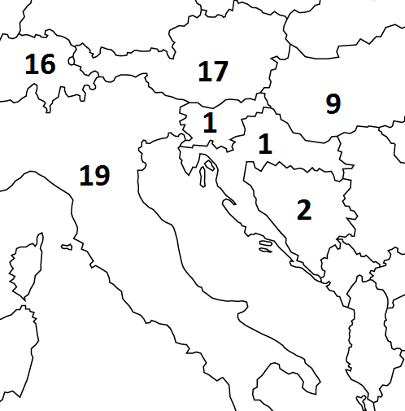
Small countries can contribute to mankind!
Nobel laureates and country of birth.

Slide 23
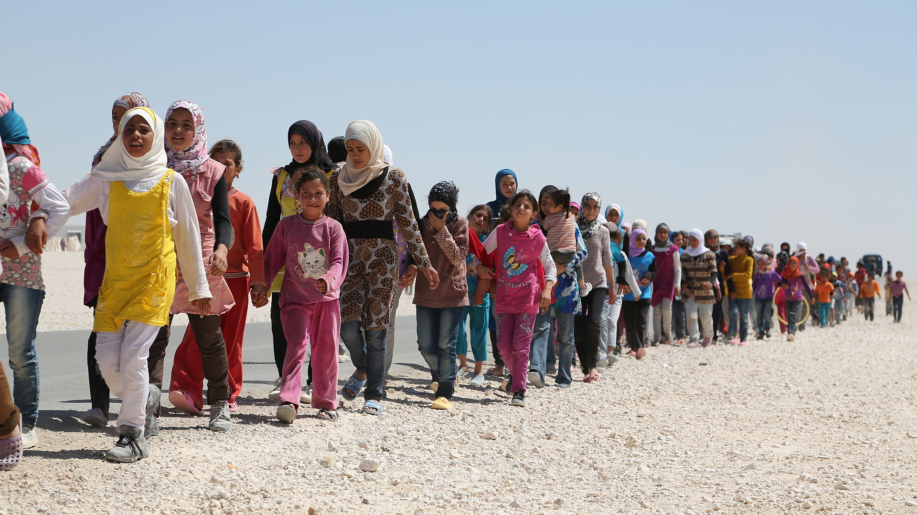
Some questions
Syrian migrants:
  Acculturation challenges?
  A security threat?
  Cheap workforce?
  Brain gain for the developed countries?

Slide 24
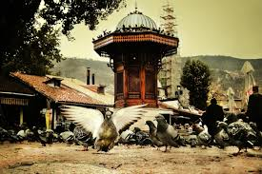
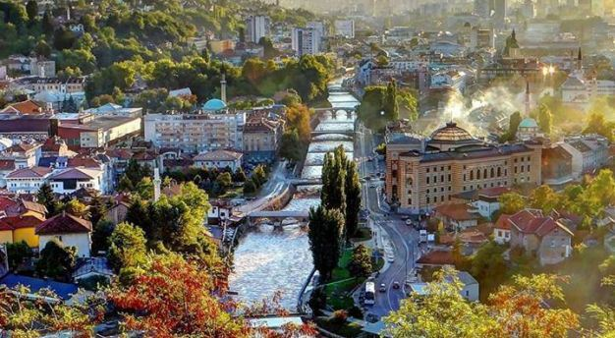
Thank you for your attention!

