Slide 1
Political Anticipation
By author Ariane Page,
Nicole de Bavelaere

Slide 2
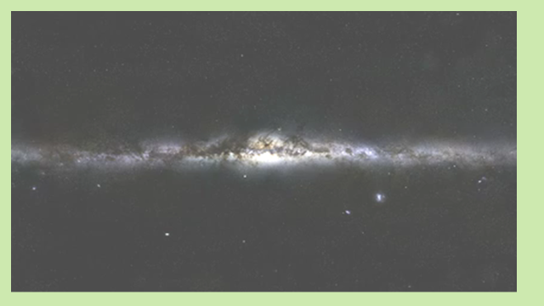

Slide 3
2) The invariance of the laws of nature and coherence of nature
Science observed order in Nature: 1) Symmetry serves as a guiding principle and triggered the quest for a unified theory
3) Mathematically , a fifth dimension is accepted
4) Quantum physics calculations are based on the existence of an Implicate Order.
The frame of reference changes the perception of what we believe nature is. But we all have to agree to the interrelation of all elements in nature, as if merged in a giant field:
UNUS
MUNDUS

Slide 4
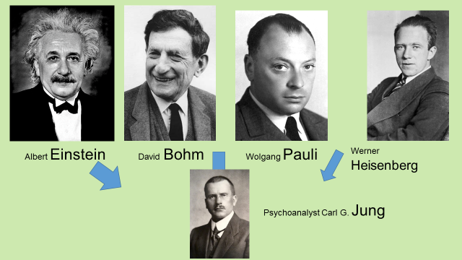
…Toward a link between Psyche and Physis

Slide 5
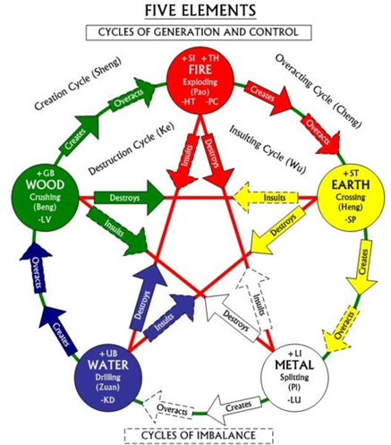
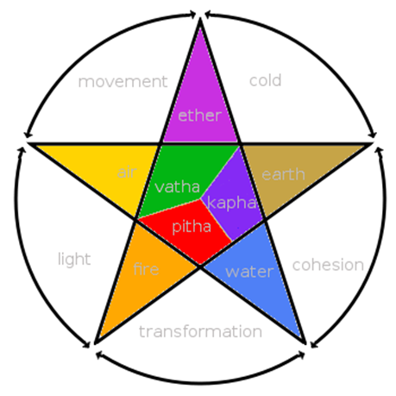
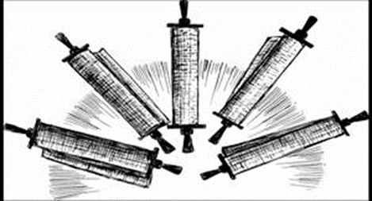
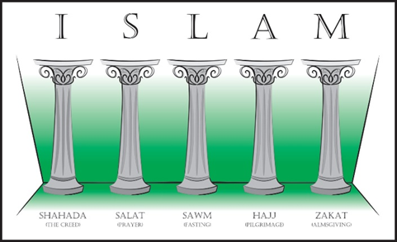
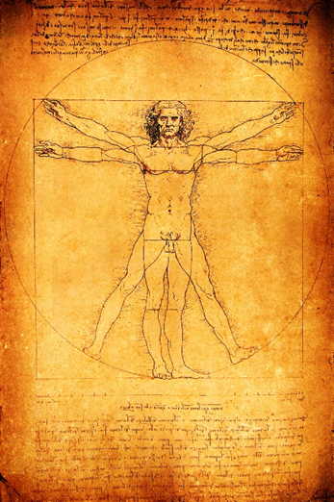
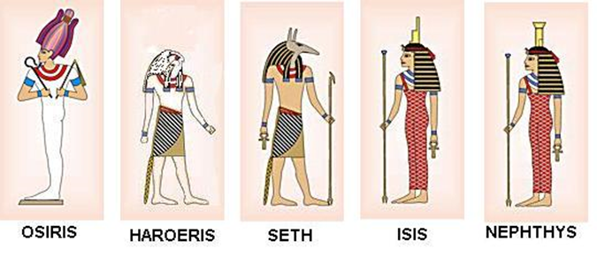
Where can we find the LIFE model?

Slide 6
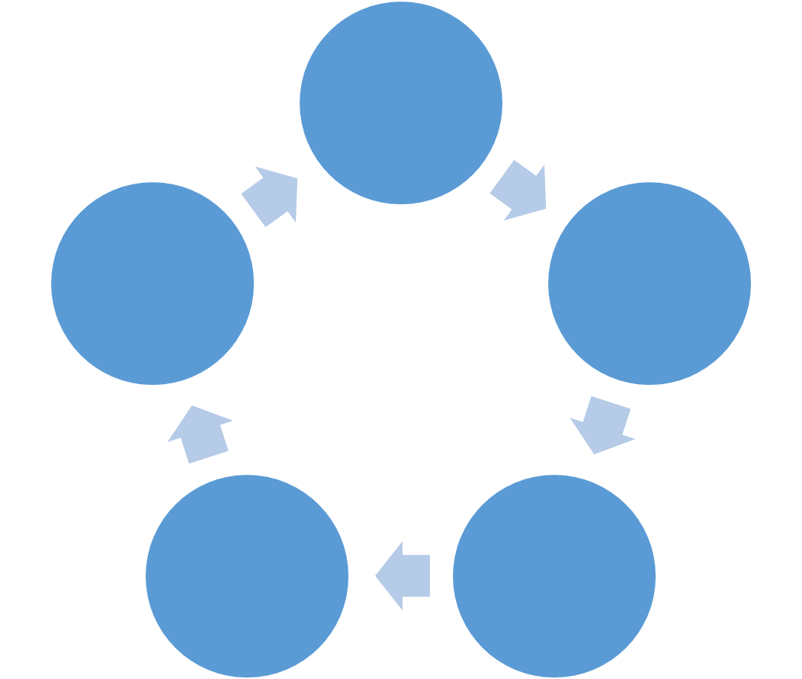
LIFE Model
…in the Brain
Conscious
Analytical
Brain
Information World
Environment
Social-Universal Brain
Human
Brain
Emotional world
Physical world
Mammalian
Brain
Reptilian
Brain

Slide 7
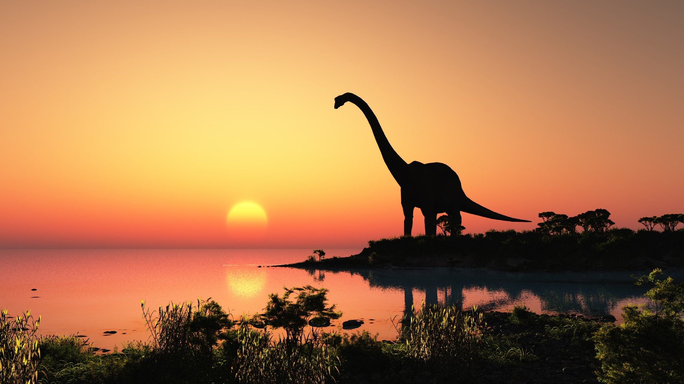
Reptilian Brain Phase : inherited from Jurassic period

Slide 8
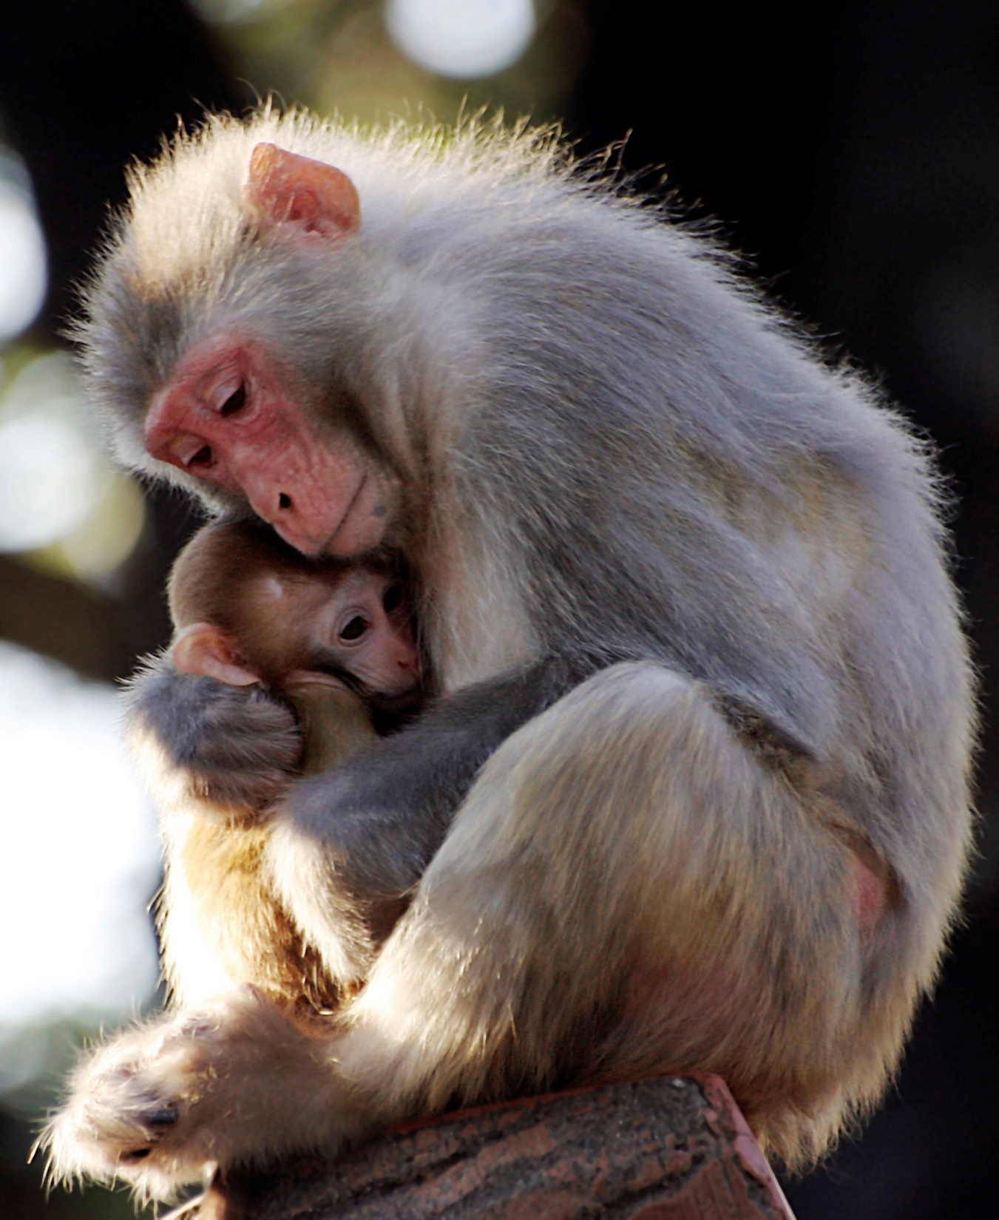
Mammalian Brain Phase:
Inherited from Cenozoic Period

Slide 9
Human (Identity) Brain
Phase: Inherited from Anthropocene period

Slide 10
Conscious Brain Phase: a result of all previous periods

Slide 11
Social-Universal Phase: the phase our civilisation is entering

Slide 12
The Brain
Unconscious and global –Right Hemisphere (RH)
Two functionally different Hemispheres = 2 Regulators
Conscious and Analytic –Left Hemisphere (LH)
5 Evolutionary Phases/ Functions

Slide 13
Canadian Democratic Government
Older brain structures are modular and binary in their approach: they imply confrontation and opposition
Courtesy of the Canadian government Library

Slide 14
LIFE Model
…in the Brain
Conscious
Analytical
Brain
Information World
Environment
Social-Universal Brain
Human
Brain
Emotional world
Physical world
Mammalian
Brain
Reptilian
Brain

Slide 15
Analytic Brain
Newer brain structures are heteromodal and cooperative: toward one common goal
Prime Minister
Physical regulator
Human brain
Social/Universal Brain
Symbolic head, Identity
Governor General
There are many checks and balances , regulation and inhibition as well as generation in this auto-regulated, general system . It is a fractal aspect of the Implicate Order, this model on which Nature unfolds. It can anticipate human evolution.
Mammalian Brain
Reptilian Brain
House of Commons
Senate

Slide 16
BIOSYNARCHY=
how nature governs
L.H. Prime Minister
R.H. Governor
2
3
5
4
1
Elected Members
People Electorate

Slide 17
5
Economy
Executive
Environment & Exchanges
Physical Structures
Legislative
Identity
Judicative
4
1
3
2

Slide 18
Proper Political Anticipation – associated to the Prime Minister’s function- is impossible in the absence of a proper compliance to nature’s model.

Slide 19
