Slide 1
Nature,
Master of Anticipation
By author Ariane Page
Nicole de Bavelaere

Slide 2
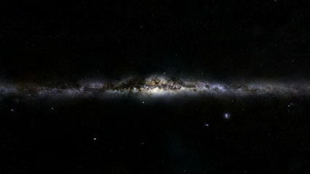
What is it?

Slide 3
the invariance of the laws of nature and coherence
Today, symmetry serves as a guiding principle in the search for further unification and progress.
frame of reference, the observer, changes perception
UNUS MUNDUS

Slide 4
Depending on the level of reference, this model is :
Ancient Egyptians would say “Five Gods”
Jung : Five Archetypes
Scientists: organises five states of matter from the fifth dimension
Nature: Master of the Five Elements (the LIFE model)
Brain: organiser of five functions
System Science: a model that informs energy (matter) through time and space, to its purpose.

Slide 5
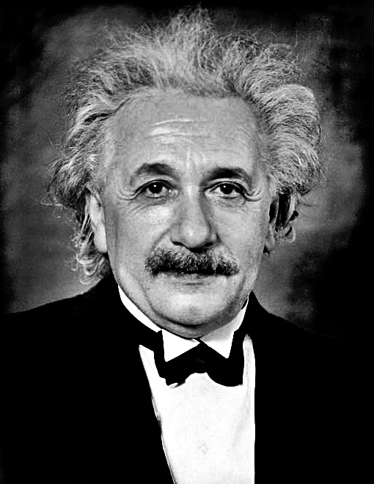
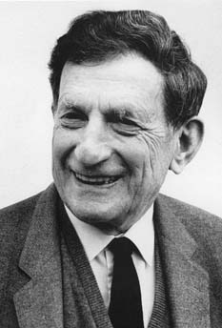
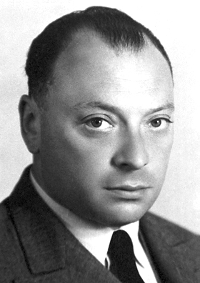
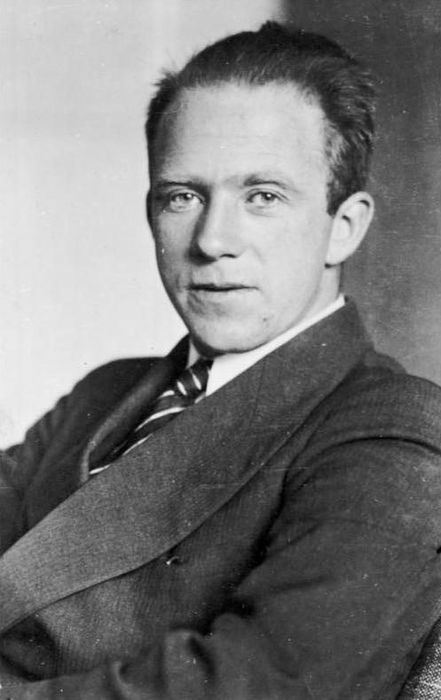
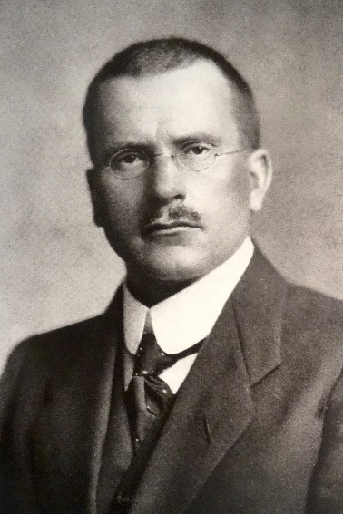
Albert Einstein
David Bohm
Wolgang Pauli
Werner Heisenberg
Psychoanalyst Carl G. Jung
What is it and Where is it?

Slide 6
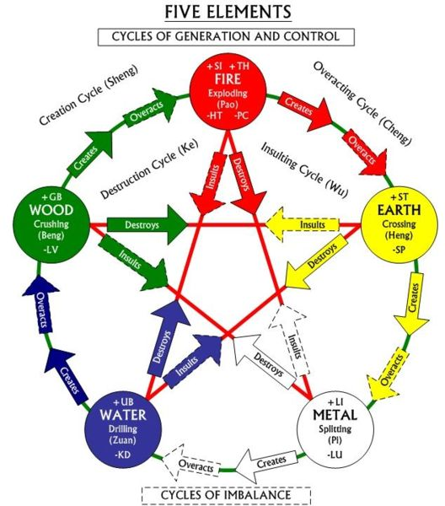
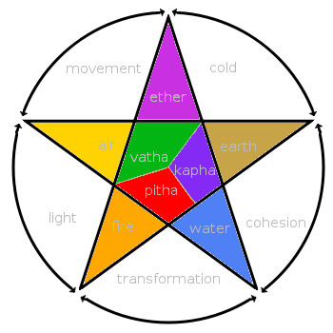
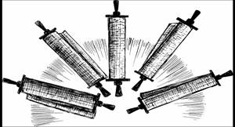
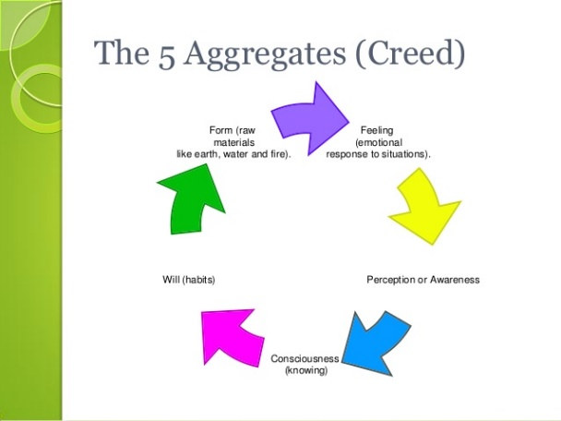
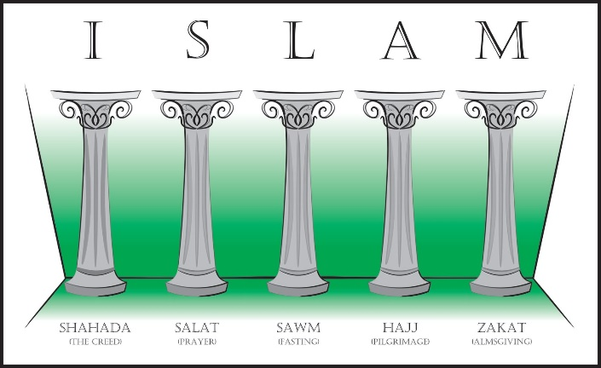
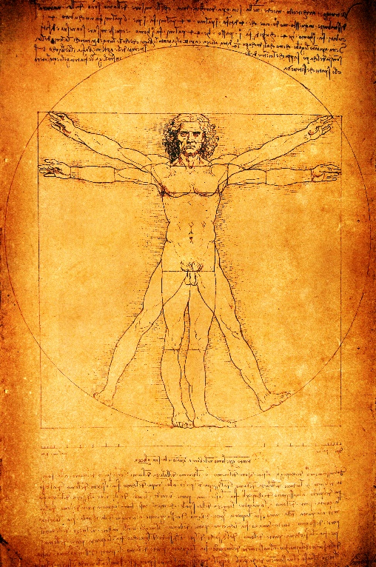
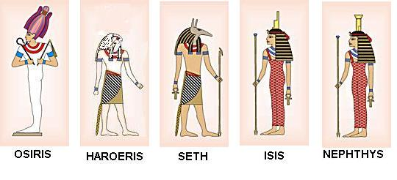
Faiths
China
India
Where do we find the LIFE model?
Art
Mythologies

Slide 7
Where else can we find it?
In the human Brain

Slide 8
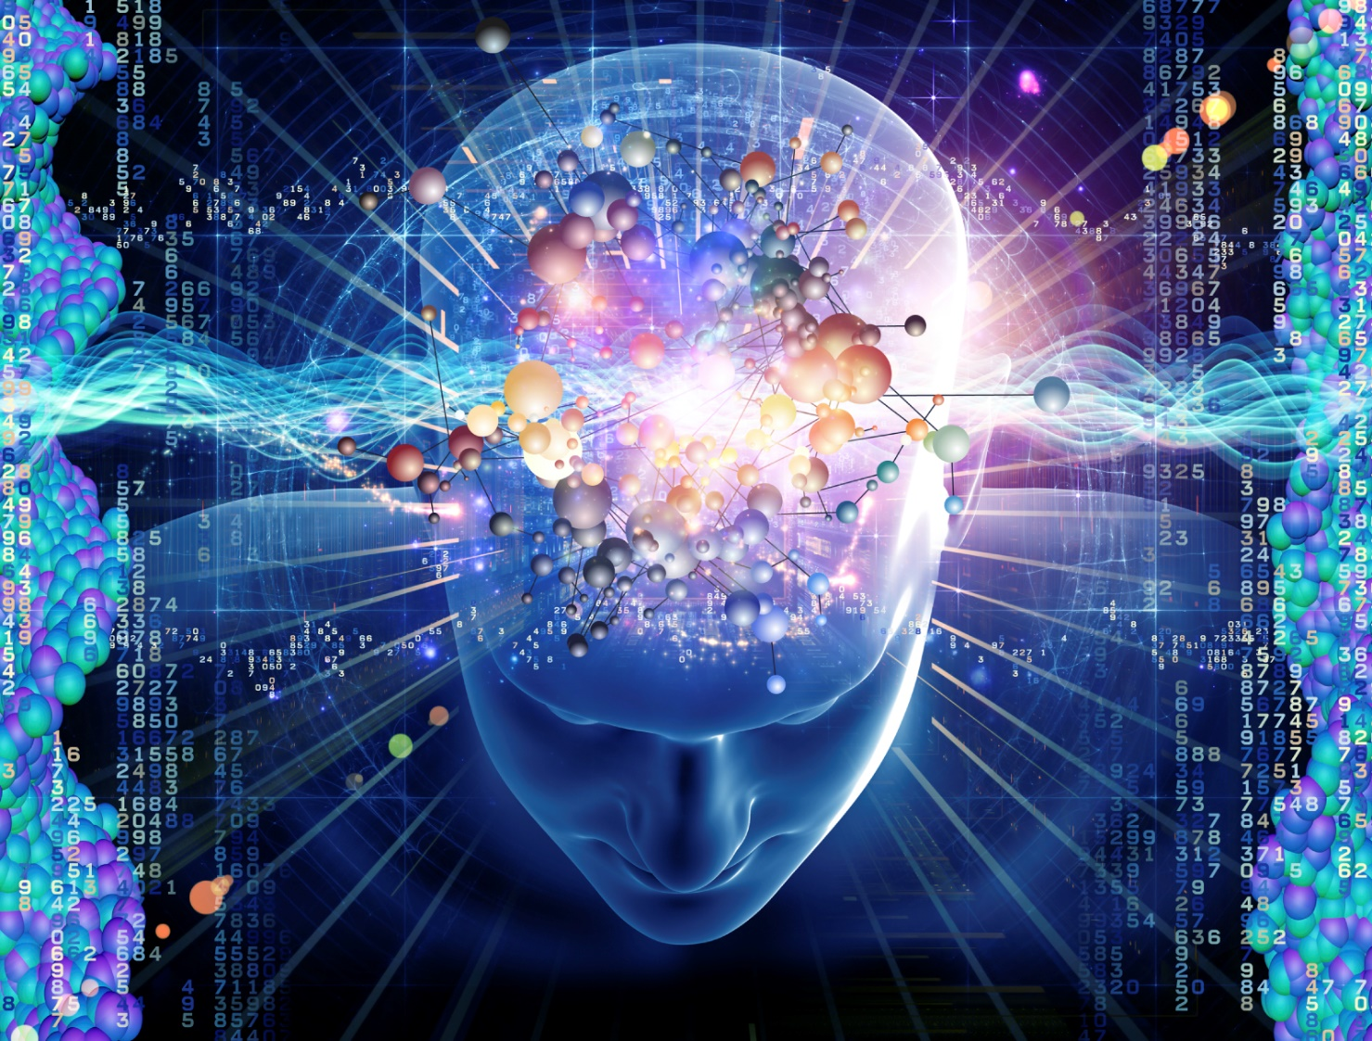
What does it says about who we are ?
Why is it?
Our science answers the what and how, philosophy answers the who and why

Slide 9


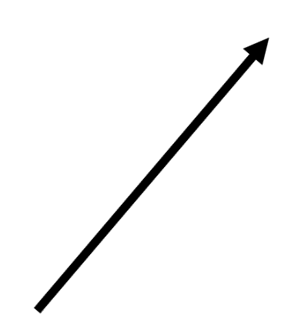
From the cell to the psyche
Analytic
universal
Reptilian
Mammalian
Human
Consciousness
5 dimensions
Nature-Exchanges
Diversity
Brain physical structures

Slide 10
Over…everything
Psychic Regulator
Analytic
Univer-sal
Reptilian
Mammalian
Human
Multilevel
Anticipative
foresight
anticipation
Universal
2nd
Global
forecast
Retension and protension
Diversified
Auto regulated
prospection

Slide 11


Slide 12
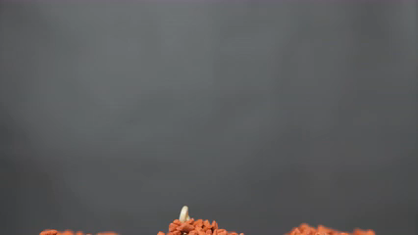

But it all starts here

Slide 13
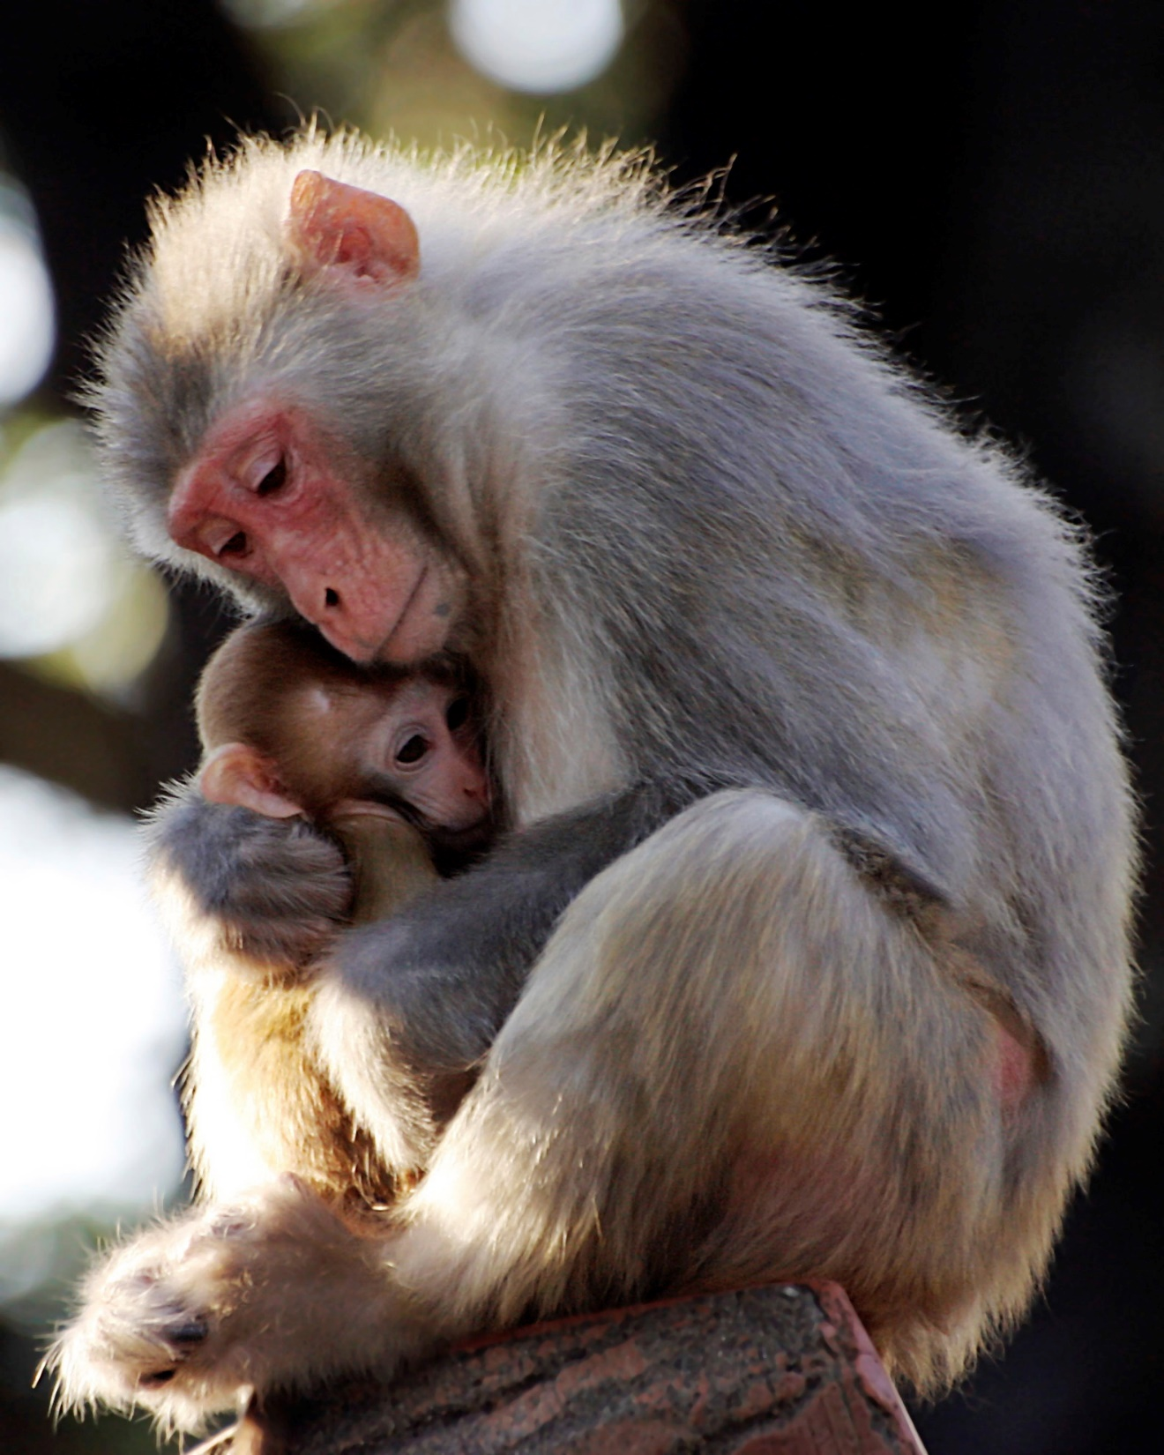
and here…

Slide 14
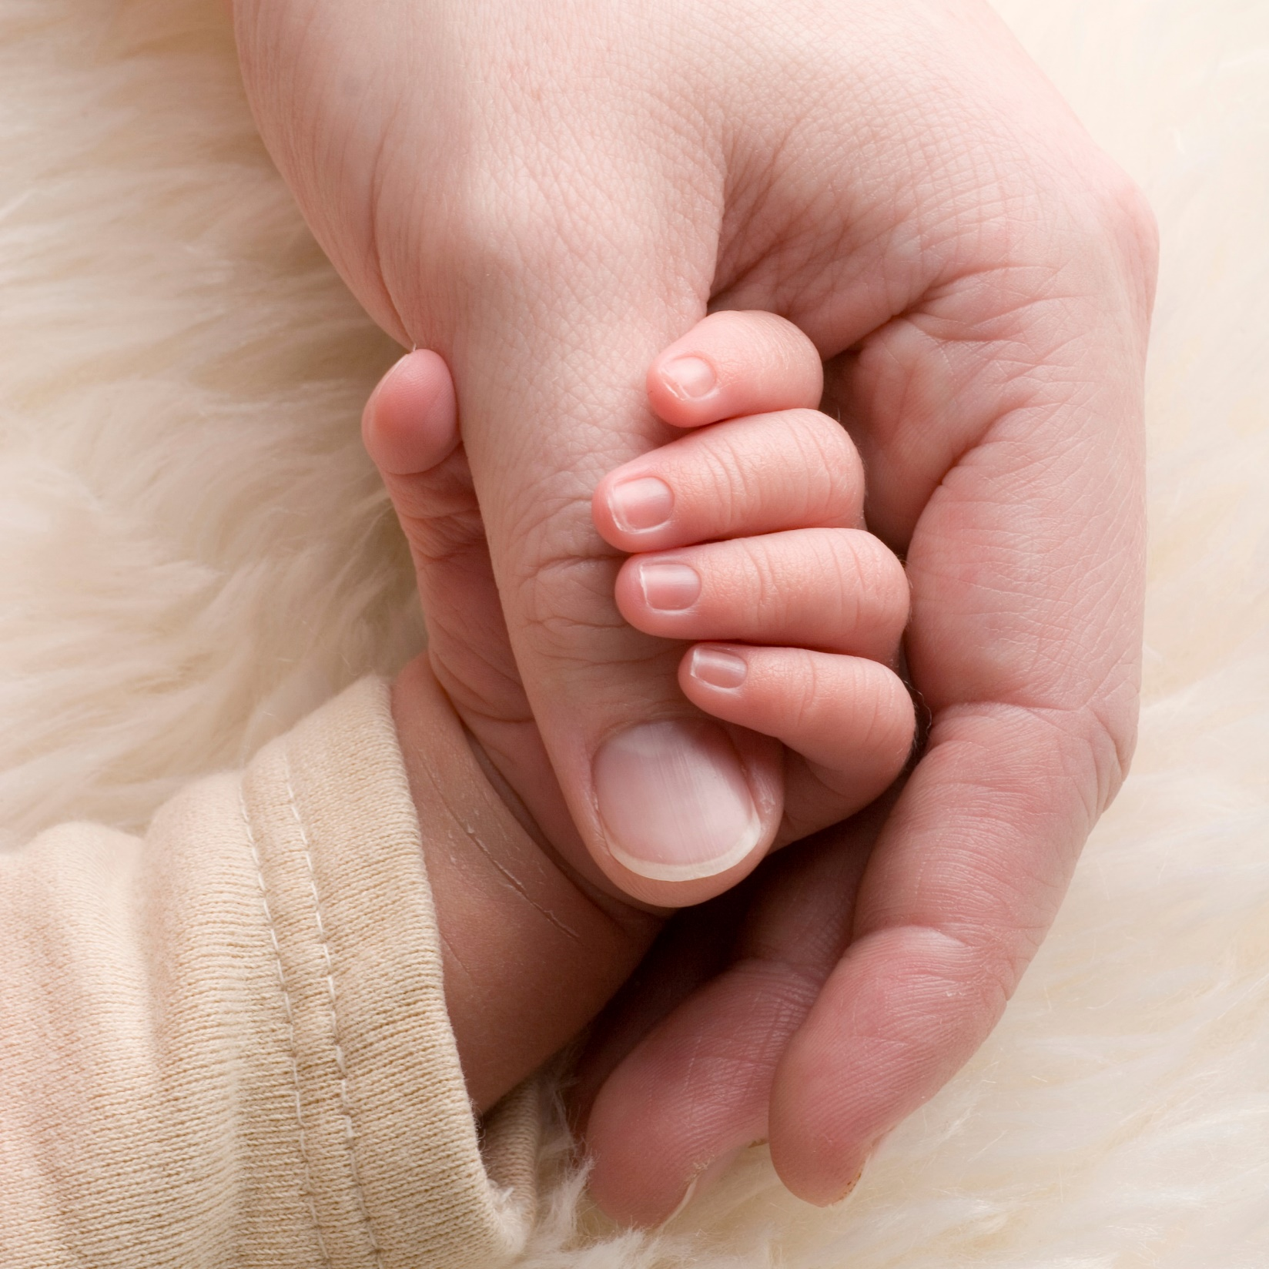
This allows nature’s nurturing
Most recent brain structures need nurturing to develop…
here……

Slide 15

and the expression of consciousness within nature
here…

Slide 16
Thank You
Grazie Mille a Tutti
Merci

